Slide 1

Earthy 4.0
Anurag Sonar 5201756 | Diederik Jilderda 4096649 | Karin Backer 4552962 | Pragya Chauhan 5319110

Slide 2
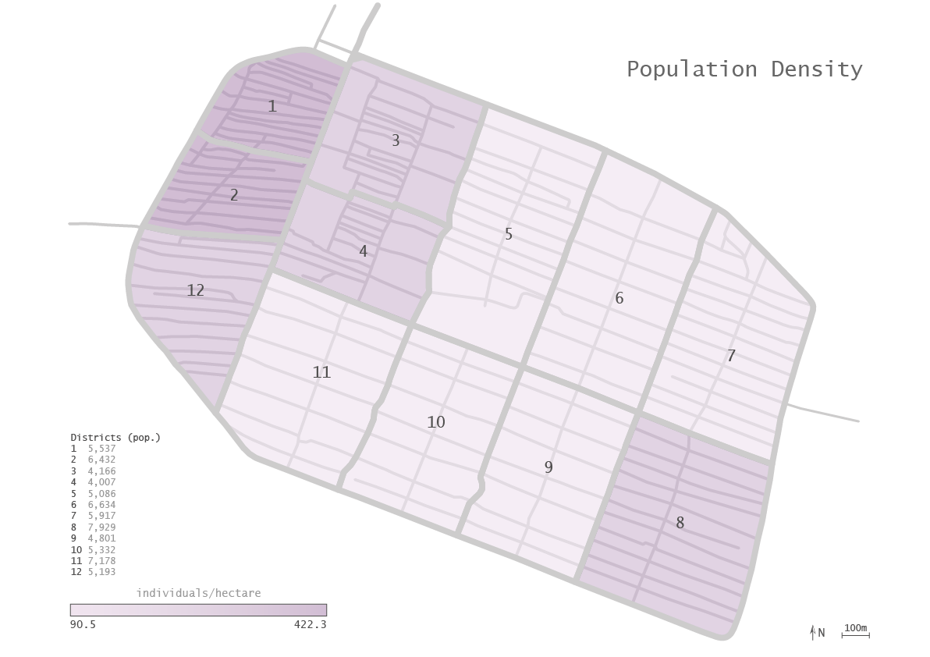
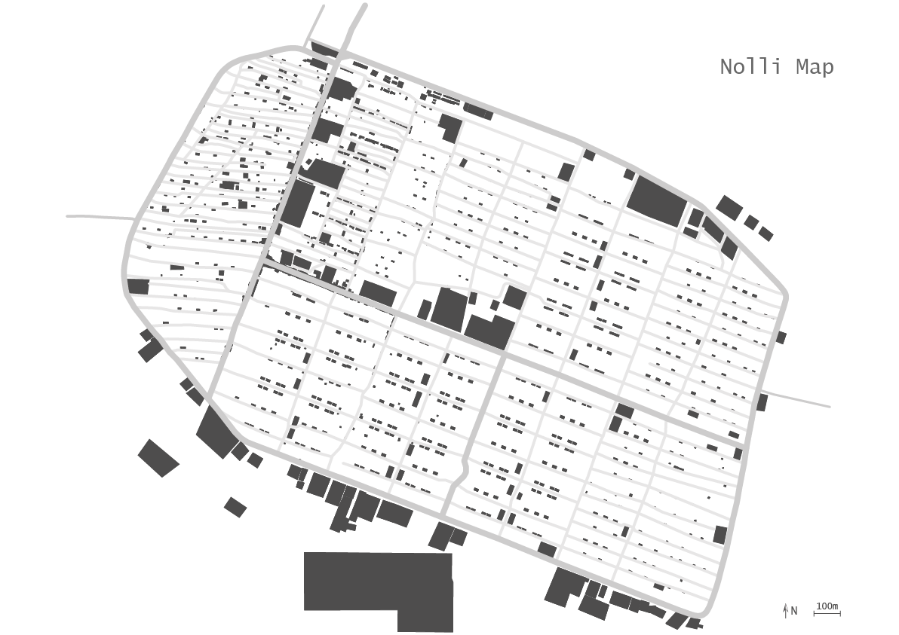
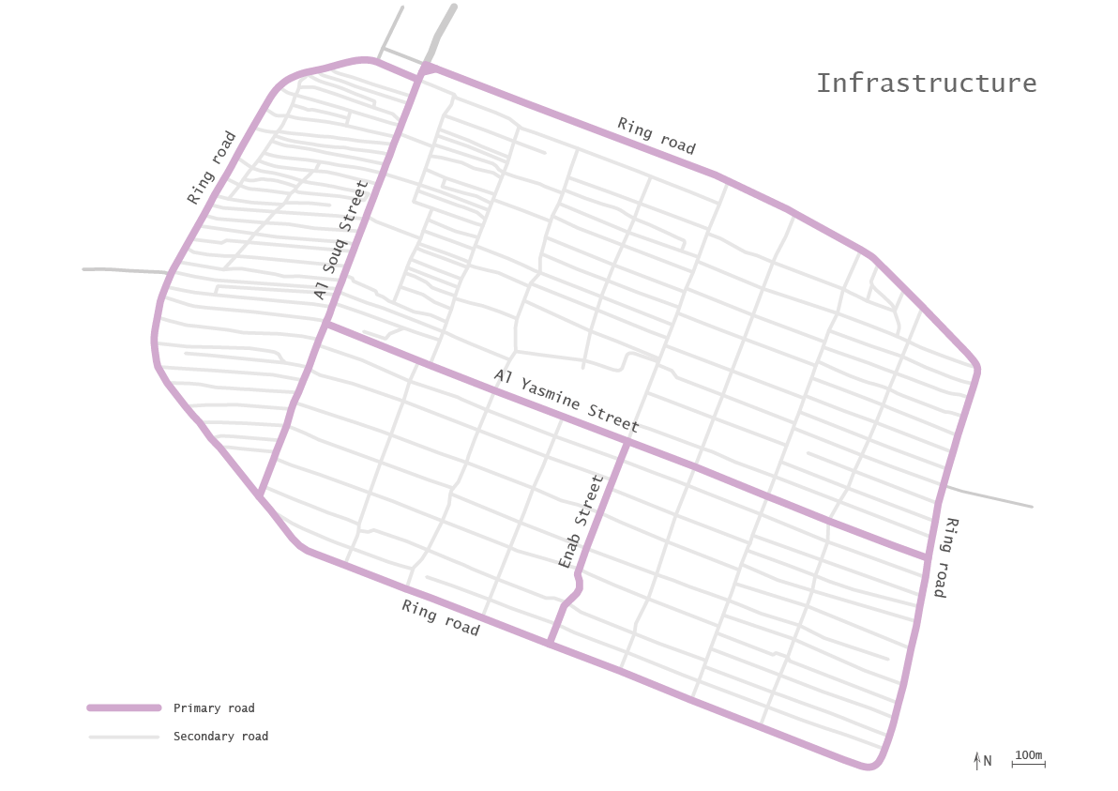
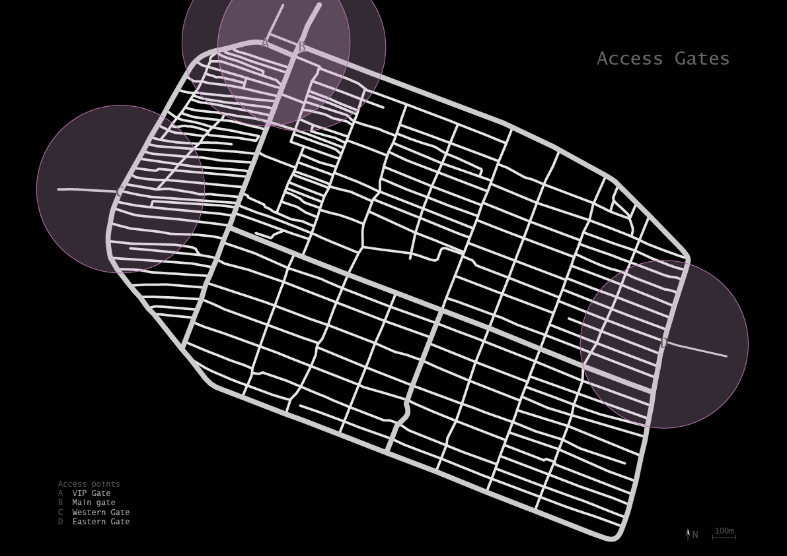
Site
Analysis

Slide 3
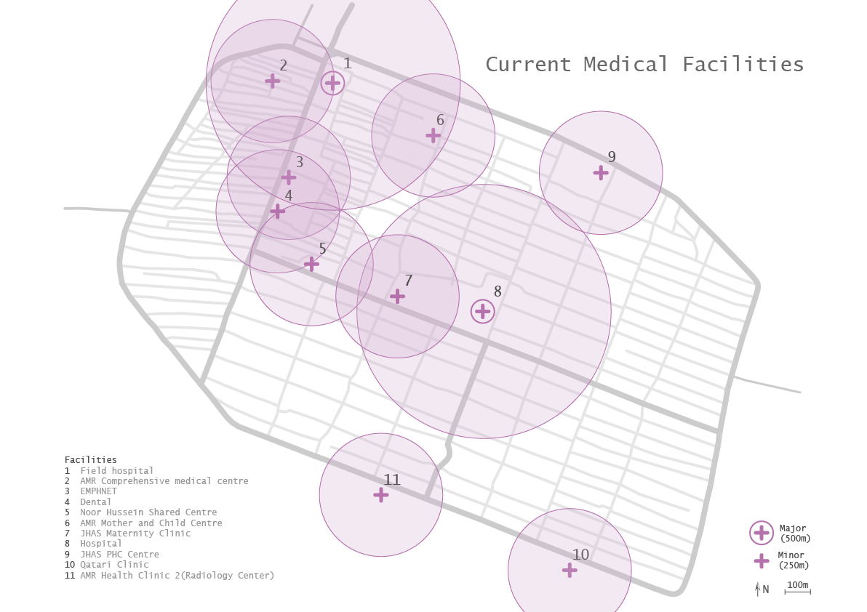
Current Facilities
Analysis

Slide 4
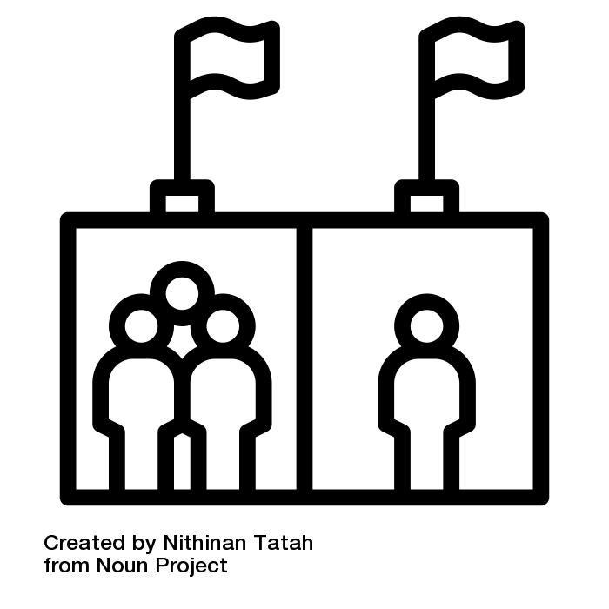
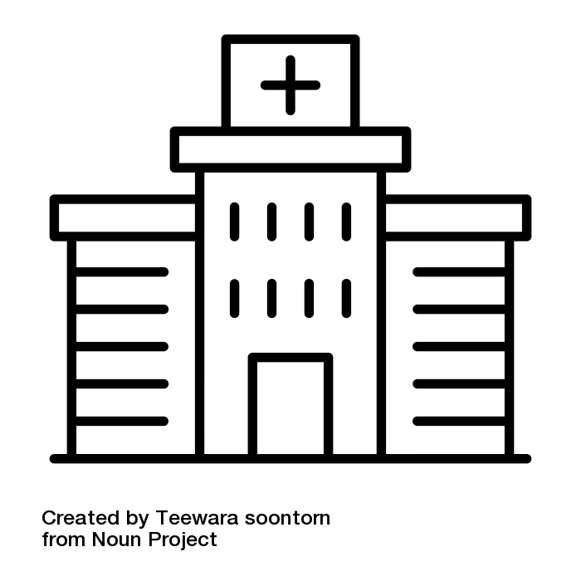
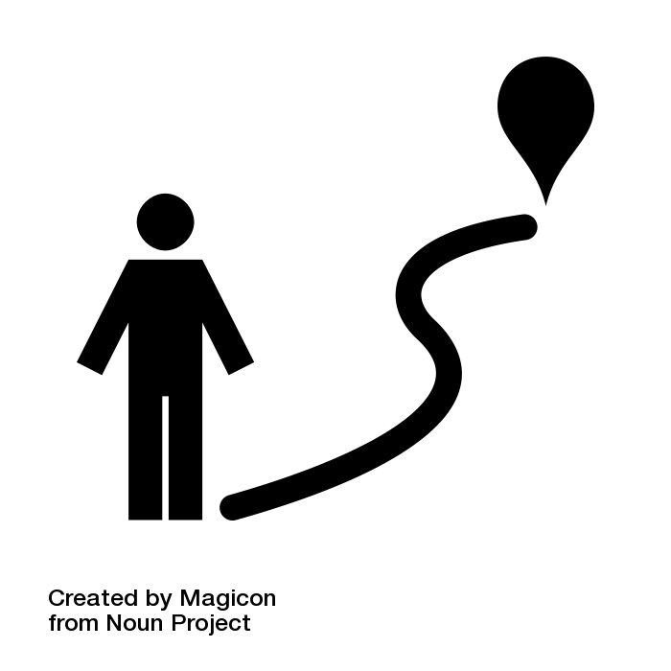
Design Problem
Analysis
Disproportionate distribution of medical facilities in sectors as per density.
High pressure on major healthcare facilities as they as less in number.
The walking distance to health care facilities is high in certain sectors, sometimes greater than 800m.

Slide 5
Design Problem
Analysis
Disproportionate distribution of medical facilities in sectors as per density.
Propose a solution for different scales of facilities.
High pressure on major healthcare facilities as they as less in number.
Focus on major healthcare facilities.
The walking distance to health care facilities is high in certain sectors, sometimes greater than 800m.
Make solution available for every locality.

Slide 6
Design Vision
Analysis
Making basic and supplementary healthcare more accessible to the people of Zaatari.
Our aim is to create a flexible tool to design hospitals based on specific local and urban needs.

Slide 7
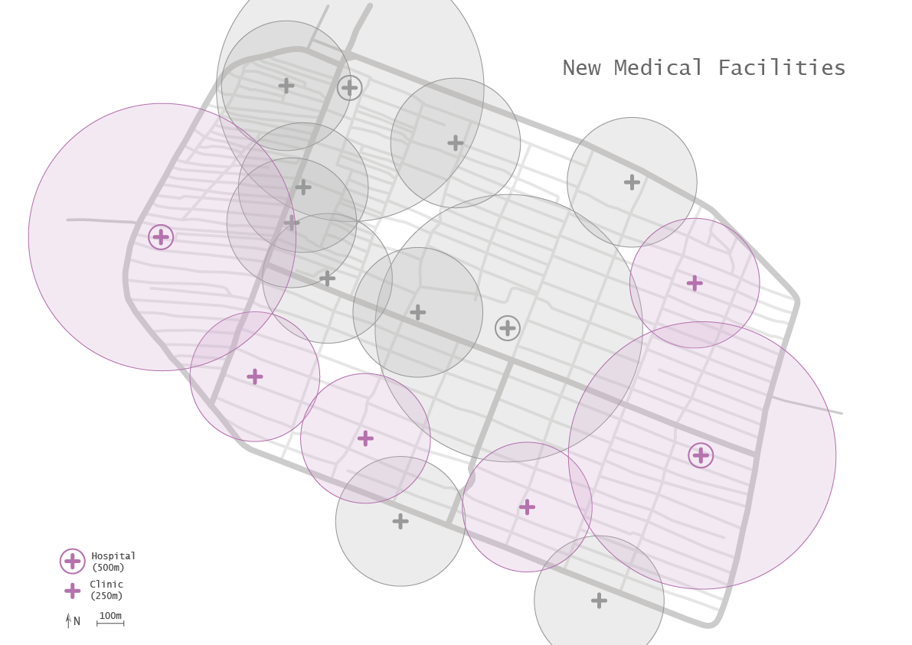
Medical Network
Analysis
Proposed scales
Clinic:
Local scale
Decentralized
Accessible
Basic care
Hospital:
Urban scale
Centralized
Efficient
Basic care
Specialized care

Slide 8
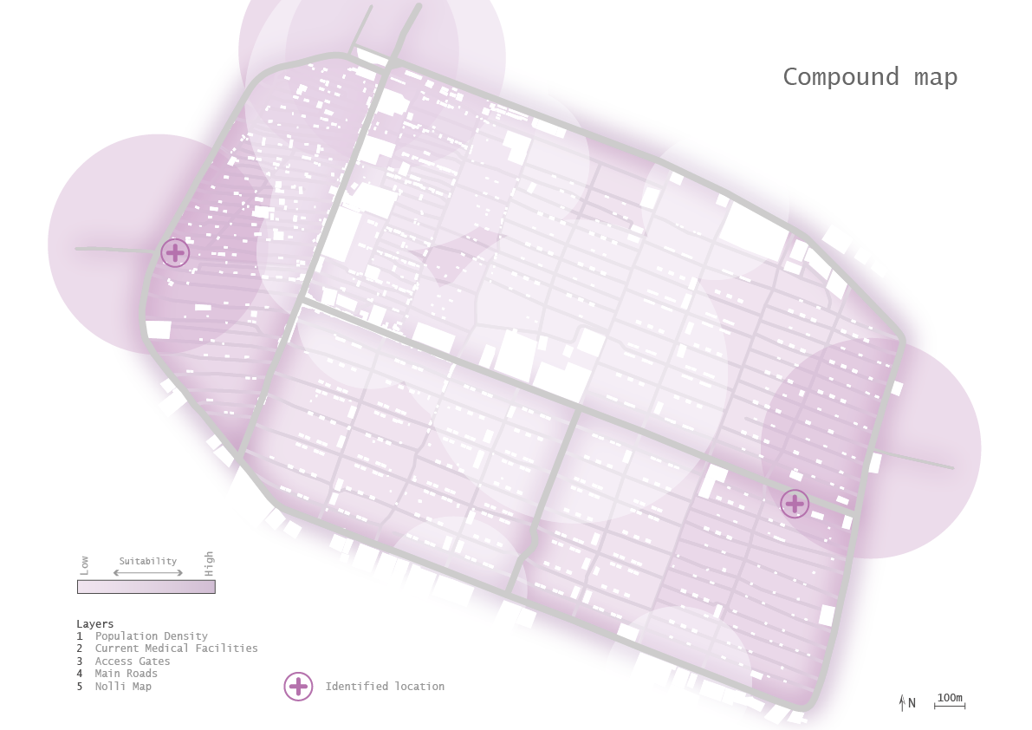
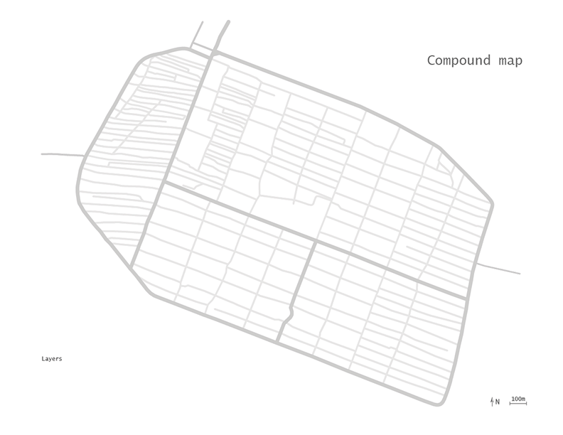
Synthesis
Analysis
Synthesis
Synthesis

Slide 9
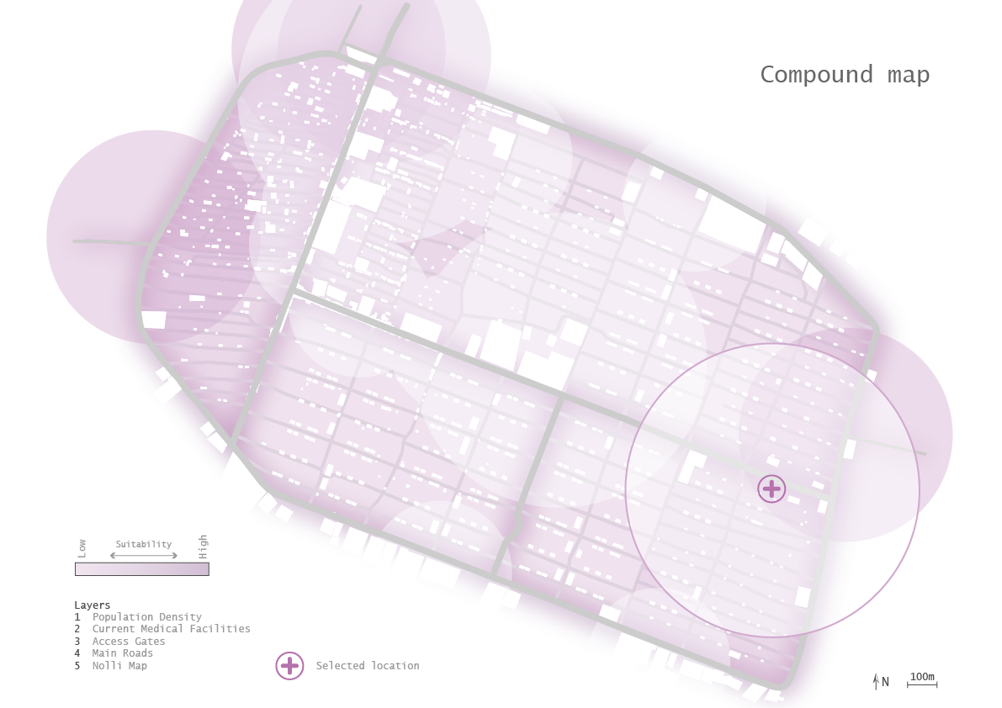
Location Selection
Analysis

Slide 10
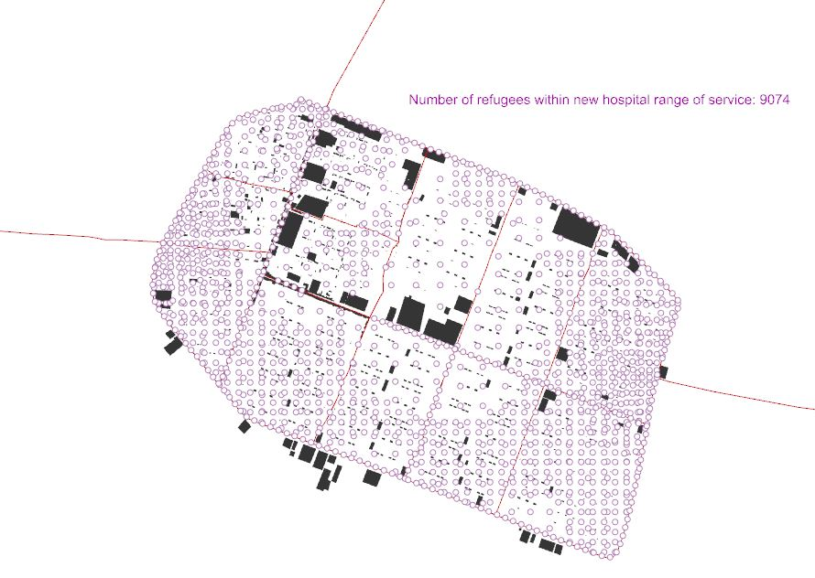
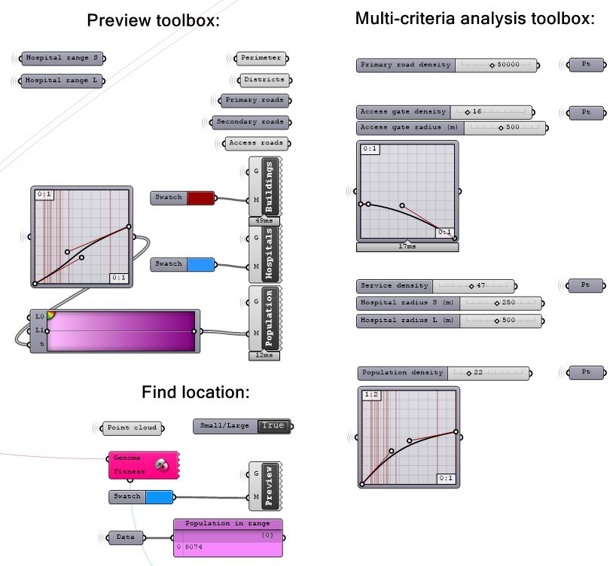
Synthesis in Grasshopper
Analysis
Notes:
Just say that we programmed the analysis in grasshopper and it calculates the number of people in our range, that is all

Slide 11
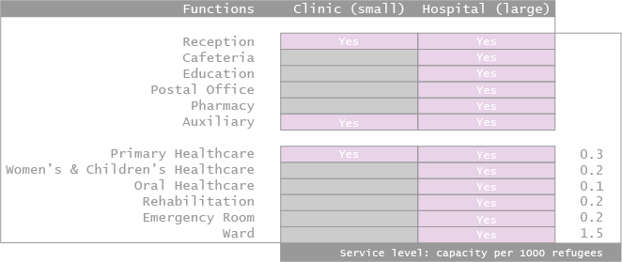
Functions by scale
Configuring
Notes:
The area of a particular function is not a number, but denoted as ‘x’. We can provide 2 times or three times the area if required.
Eg - there can be 2 women and child care units in a district which has a larger population of children.

Slide 12
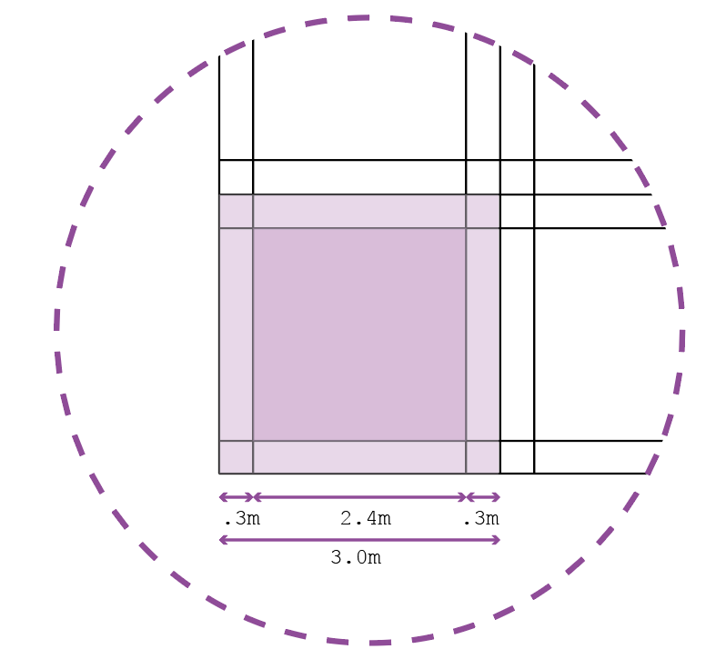
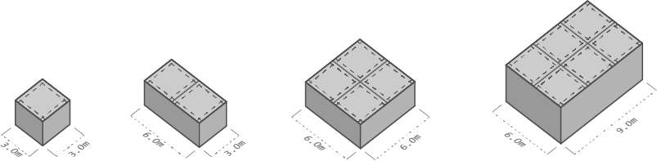
Size of Spatial Units
Configuring
Basis - Circulation
Double tartan grid:
3.0m primary
2.4m secondary
0.3m bands
1x1
2x1
2x2
3x2

Slide 13
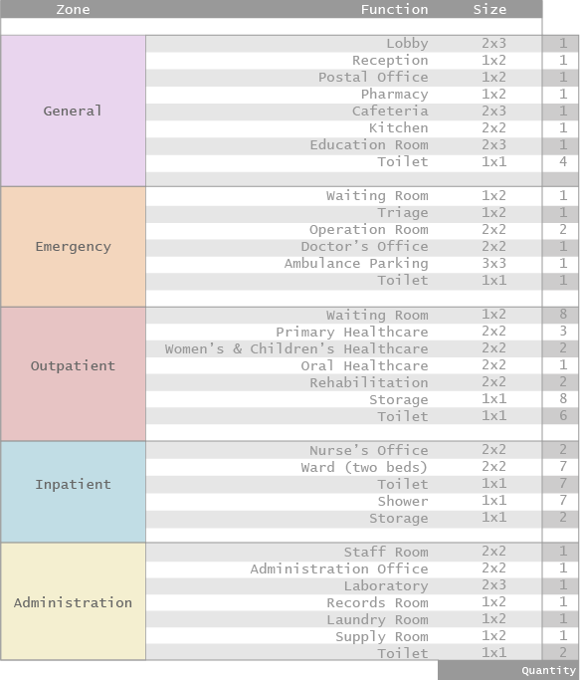
Full Program
Configuring

Slide 14
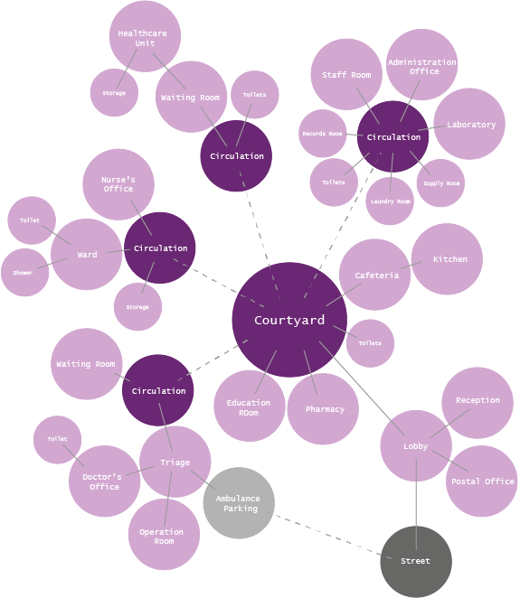
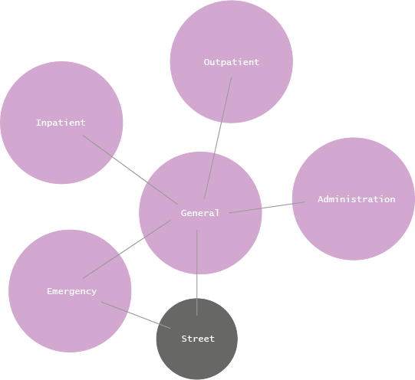
Bubble diagram
Configuring
Bubble diagram of zones
Bubble diagram of functions

Slide 15
Gamification - Why?
Bottom-to-top approach:
High degree of flexibility.
Directly involving the end user in the design of their environment can strongly improve the quality of the plan.
Empowering displaced refugees.
Configuring
Notes:
Extra control to user to design spaces as required.

Slide 16
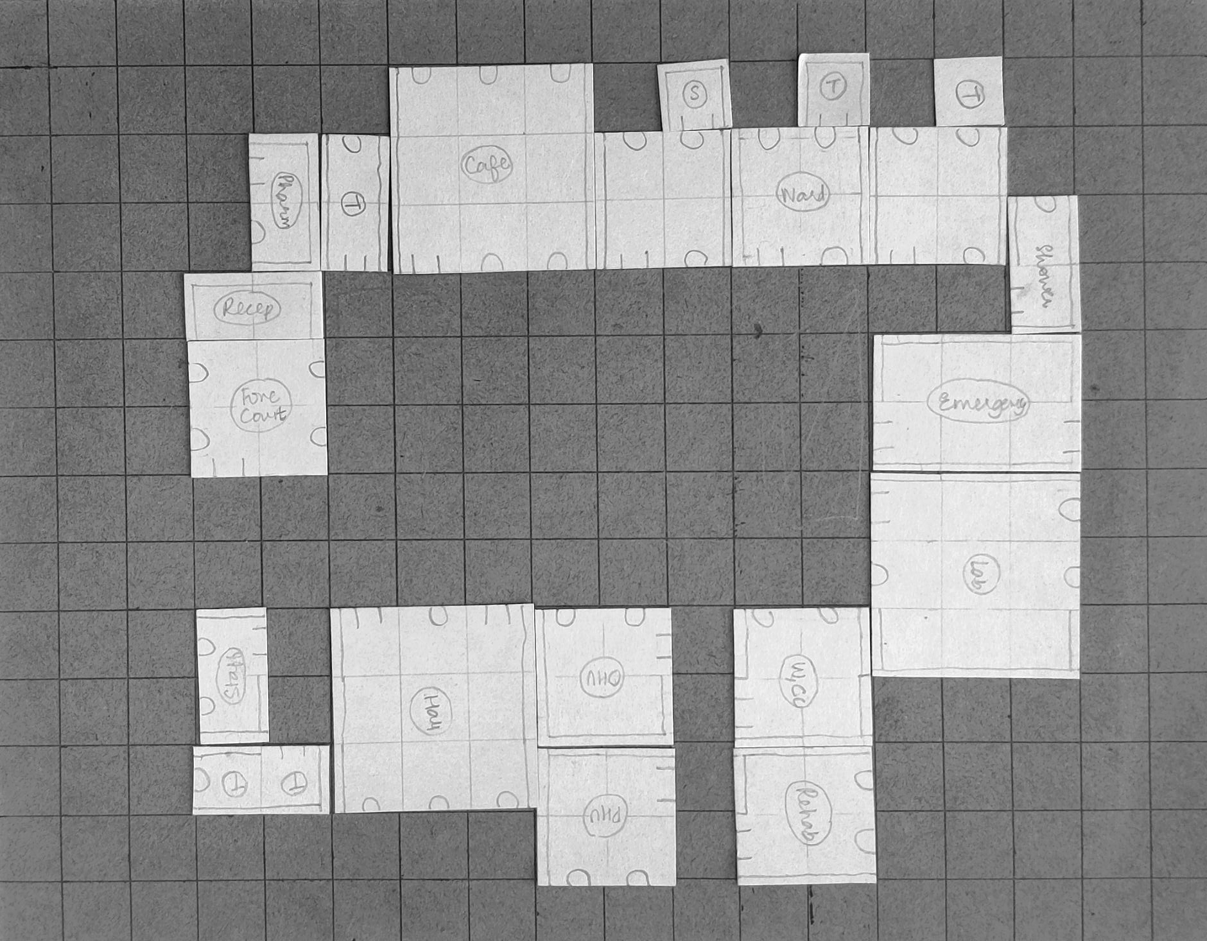
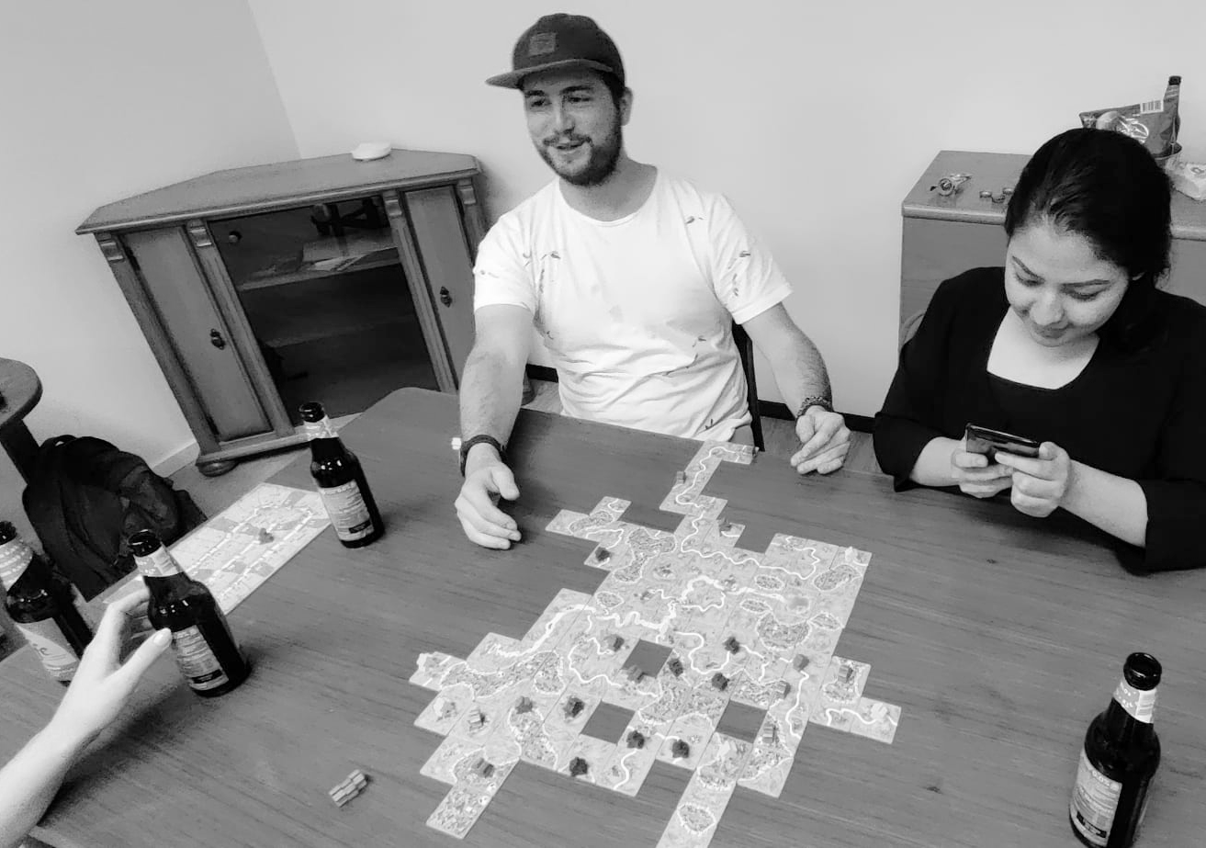
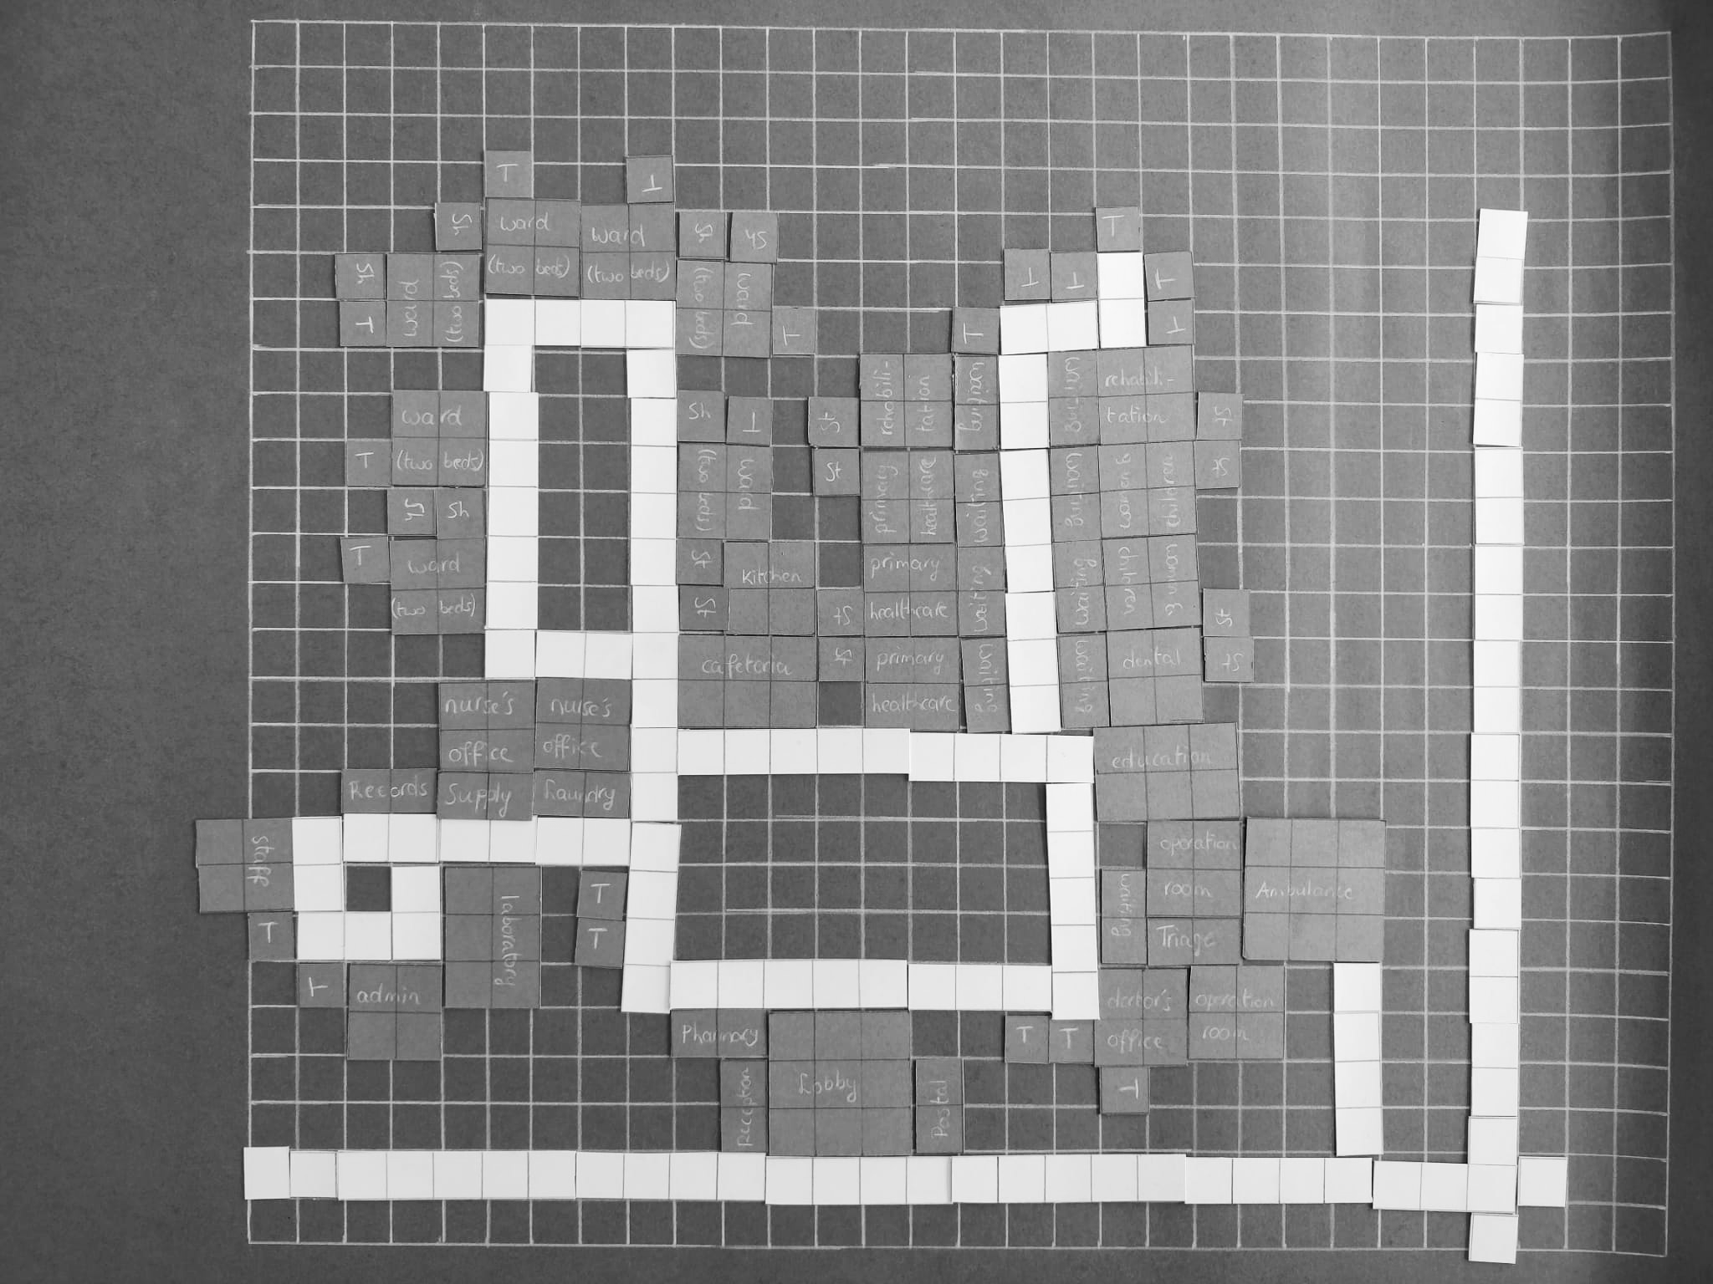
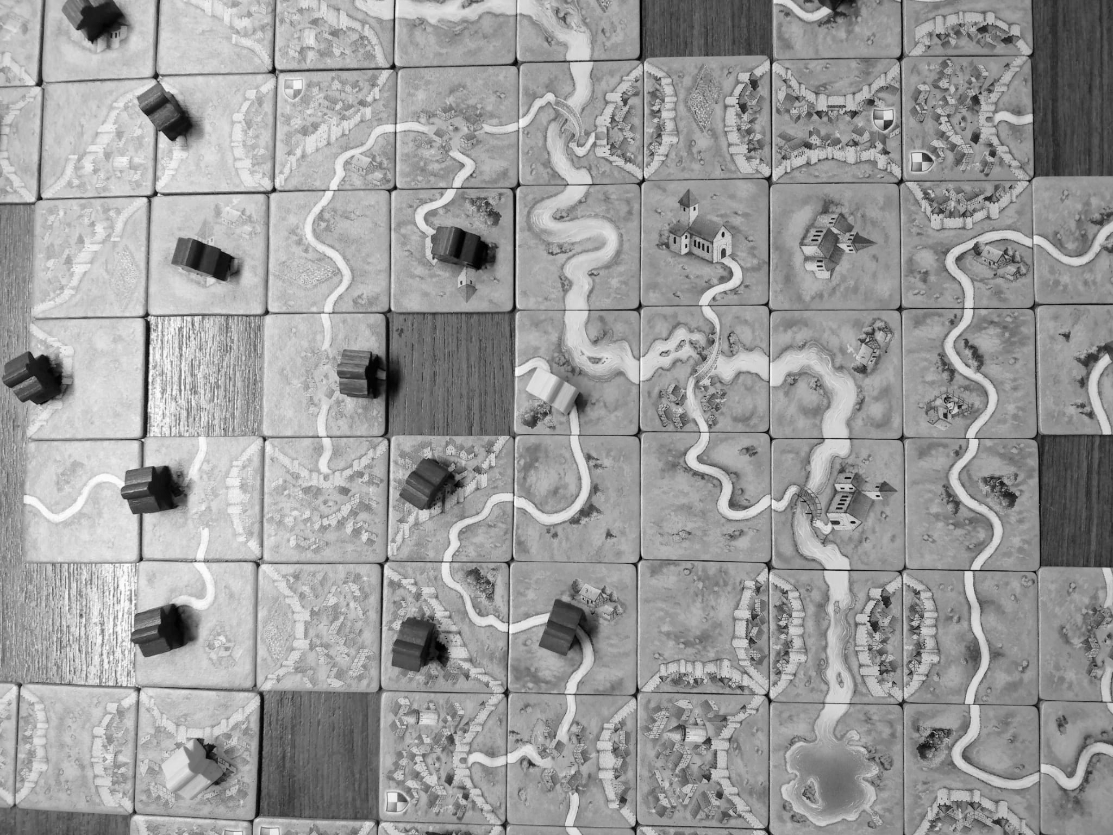
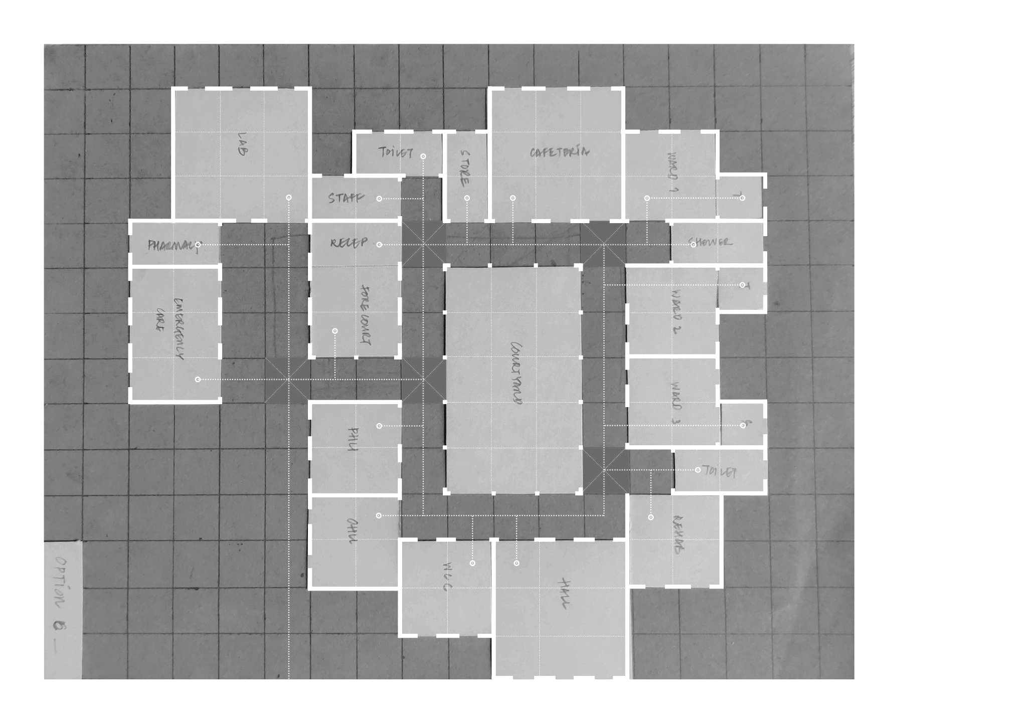
Game development
Configuring
Week 5
Week 4
Week 6
Week 8

Slide 17
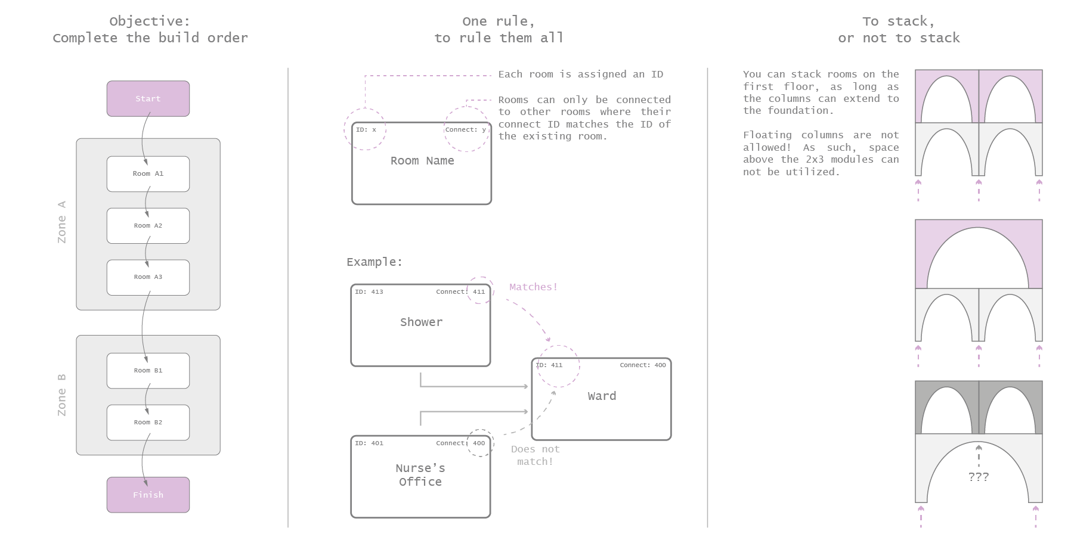
Rules of the Game
Configuring

Slide 18
Rules of the Game
Configuring

Slide 19
Rules of the Game
Configuring

Slide 20
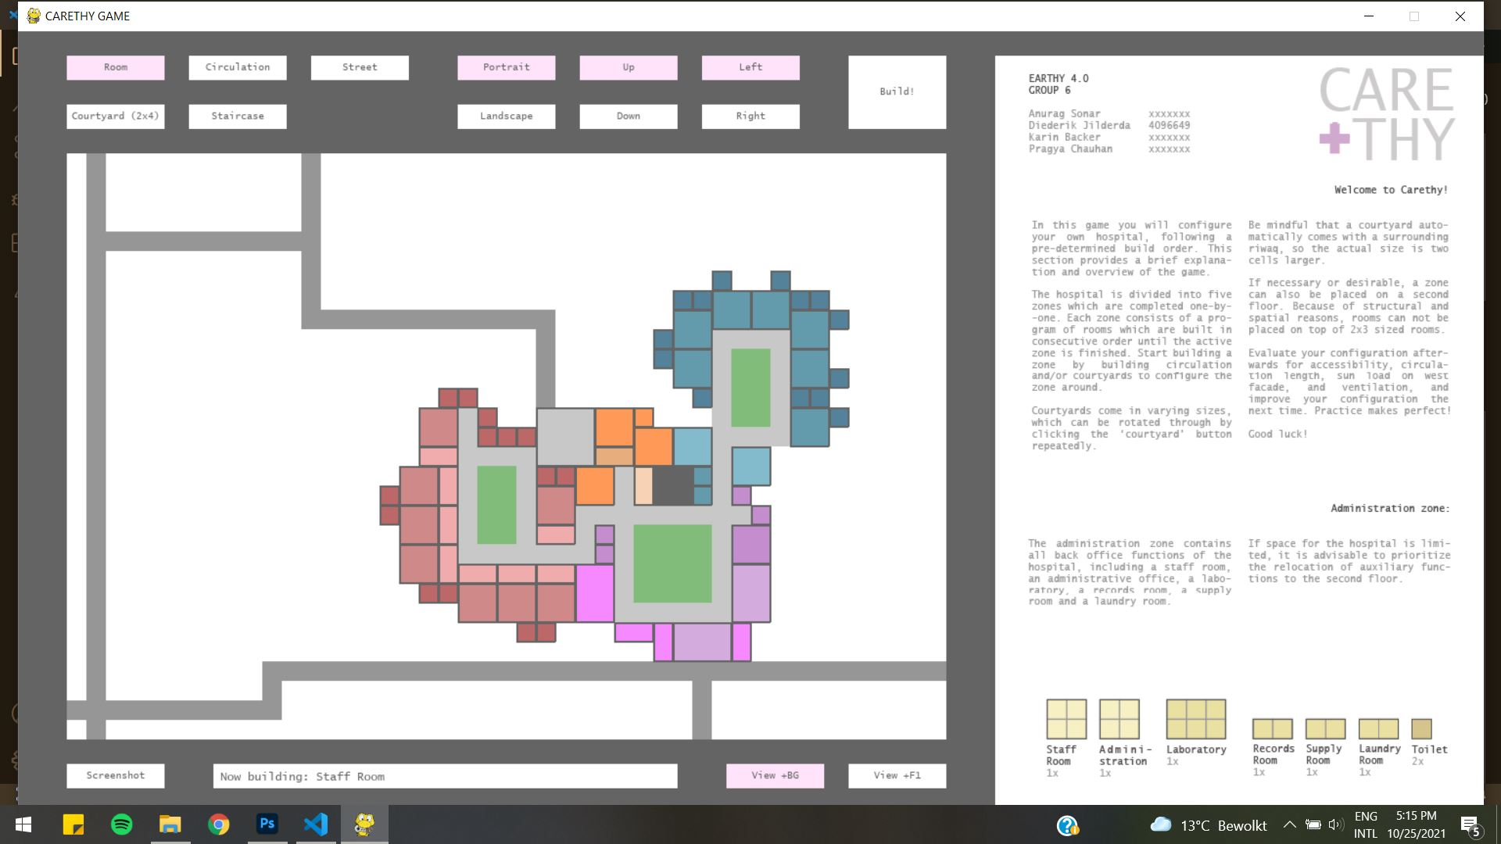
Pygame
Configuring

Slide 21
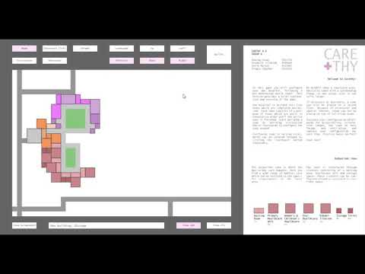
Pygame - demonstration
Configuring

Slide 22
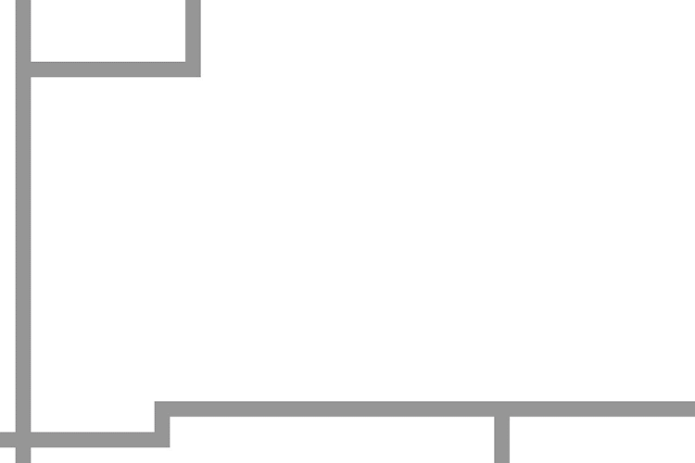
Chosen Plan Configuration
Entrance Zone
General Zone
Emergency Zone
Outpatient Zone
Inpatient Zone
Admin Zone
Courtyards

Slide 23
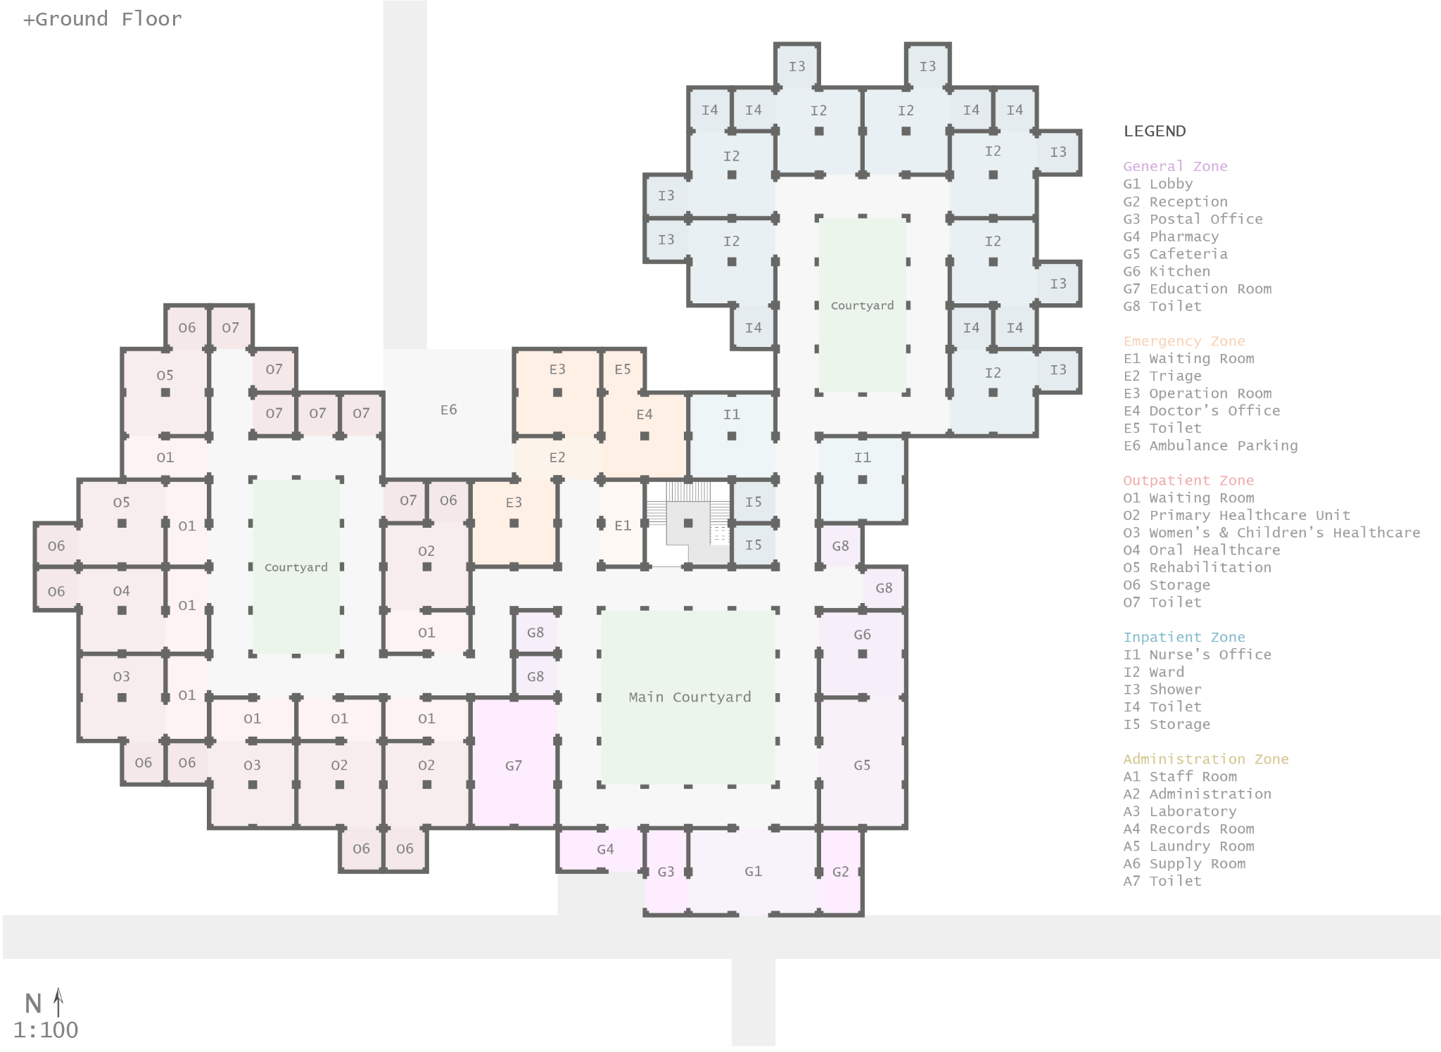

Final floor plan
Configuring

Slide 24
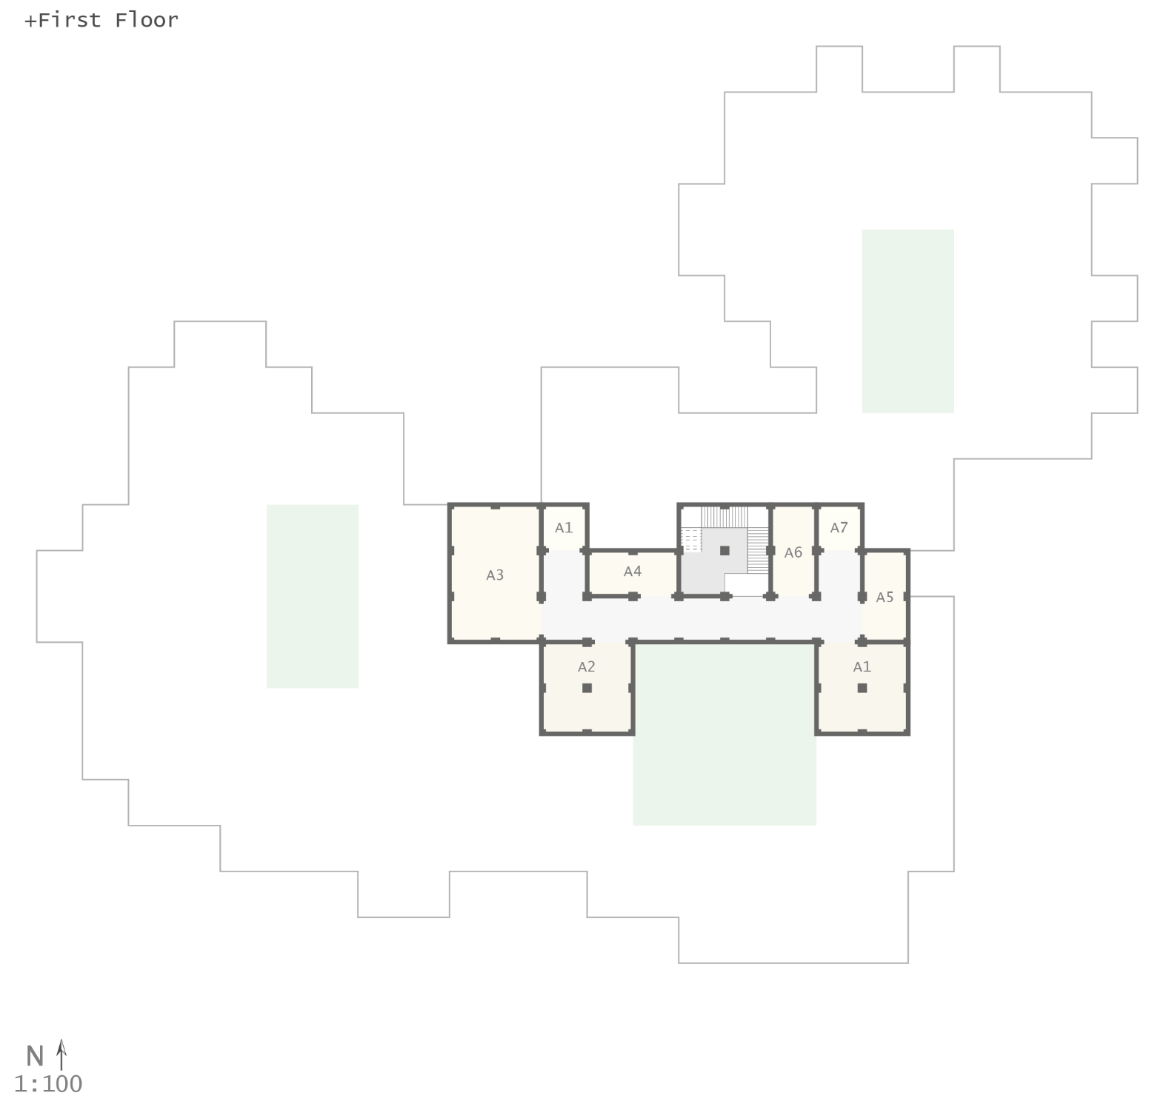
Final floor plan
Configuring

Slide 25
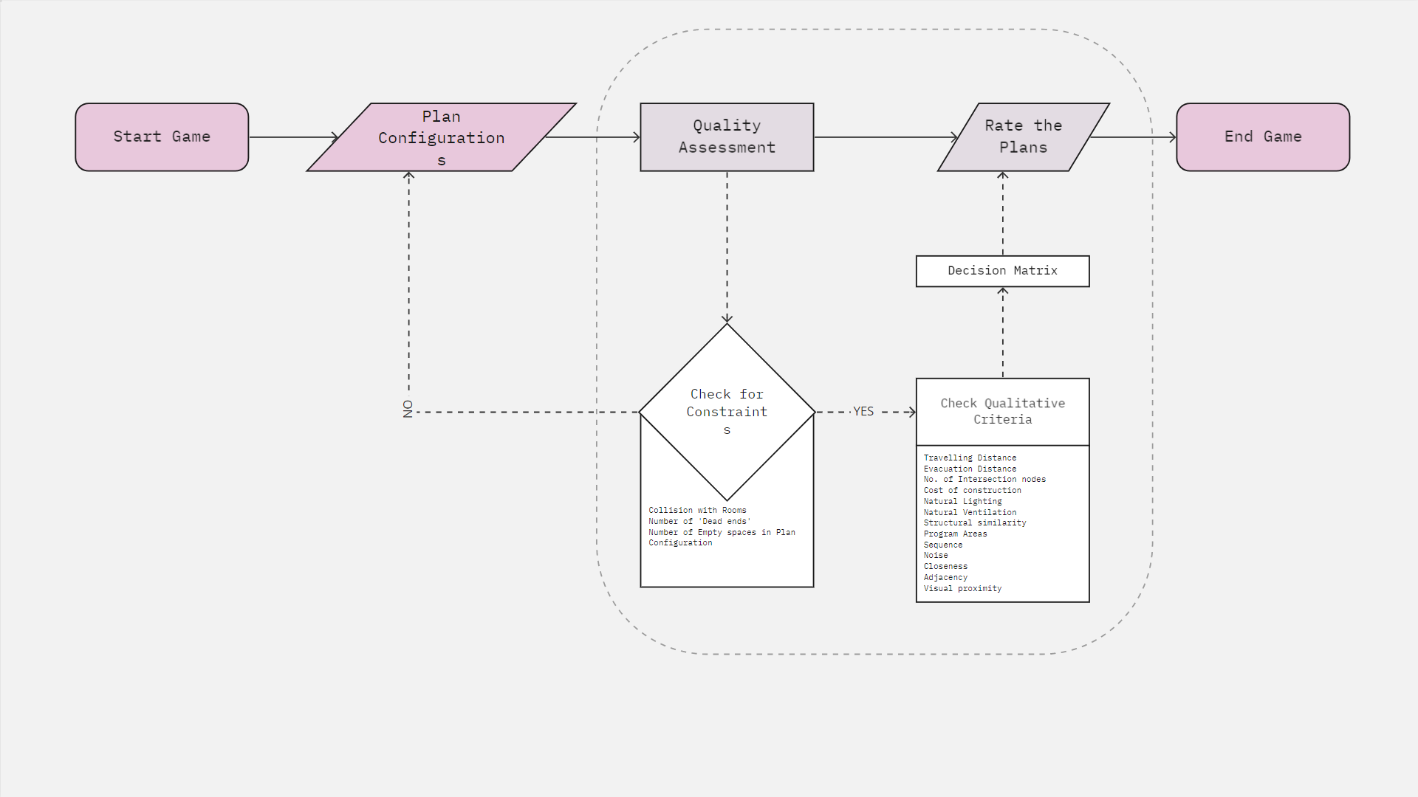
Evaluation of the Plan
Configuring
Notes:
Currently the game is designed to be played multiple times to improve the Qualitative Criteria.
We incorporate some criteria like ‘Closeness’ and ‘Adjacency’ within the game.
But to allow more freedom while designing, this can be instead a part of the Evaluation.

Slide 26
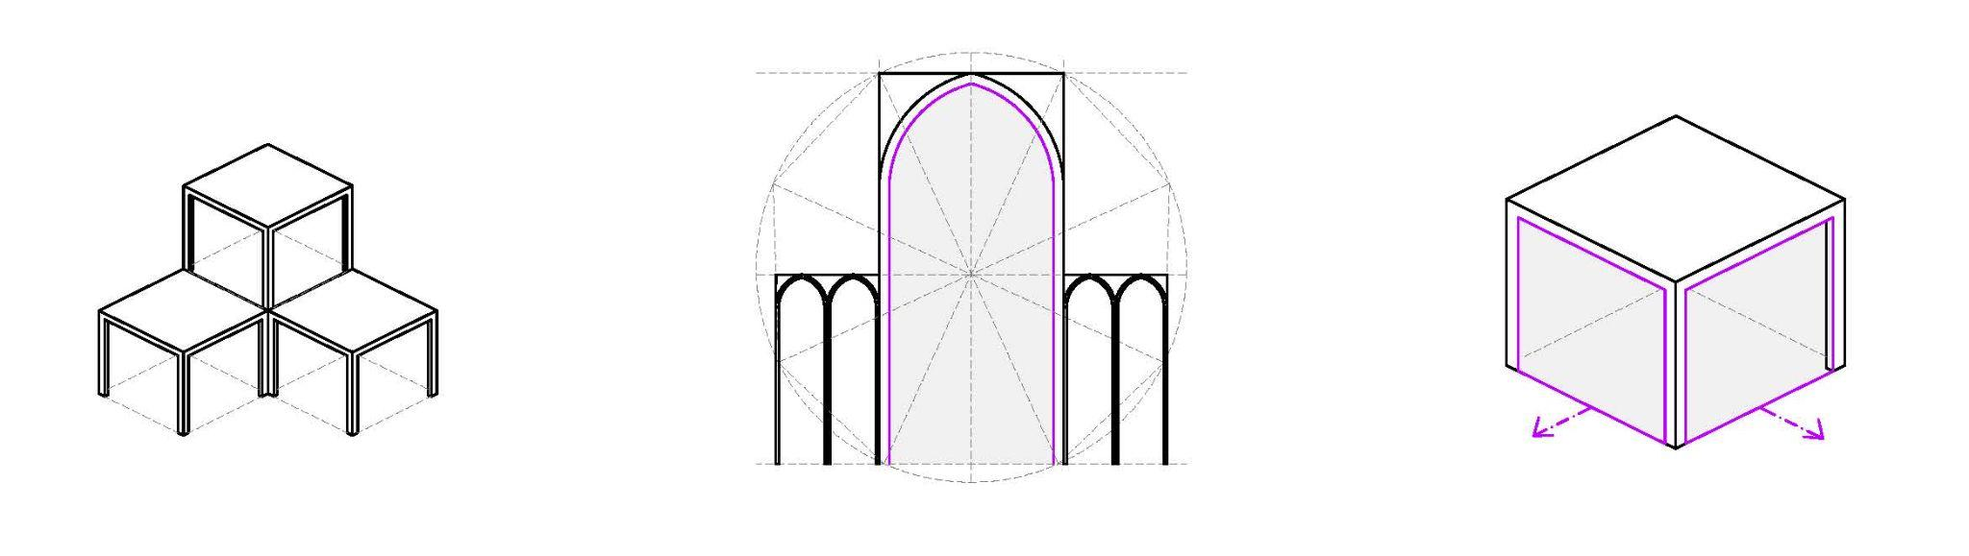
Shaping Vision
Shaping
Structural Modularity
Effective load distribution with Large openings
Flexibility in Wall openings

Slide 27
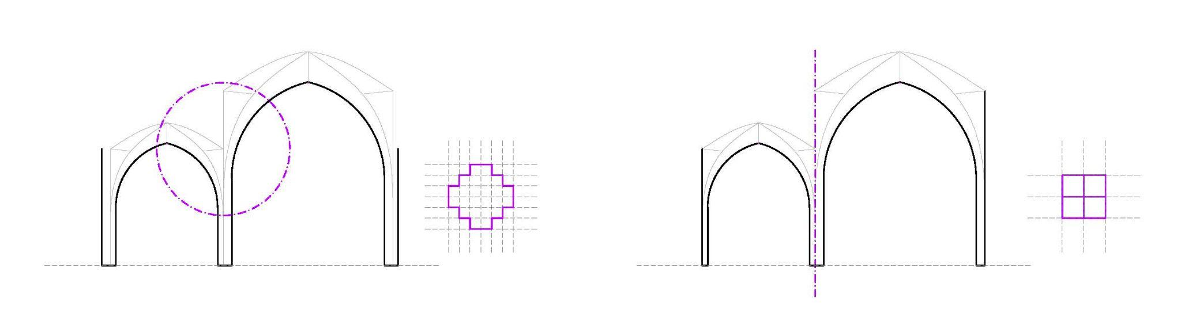
Simplification
Not Modular
Modular
Shaping
Sharing the load in between 2 units
Splitting into self standing units

Slide 28
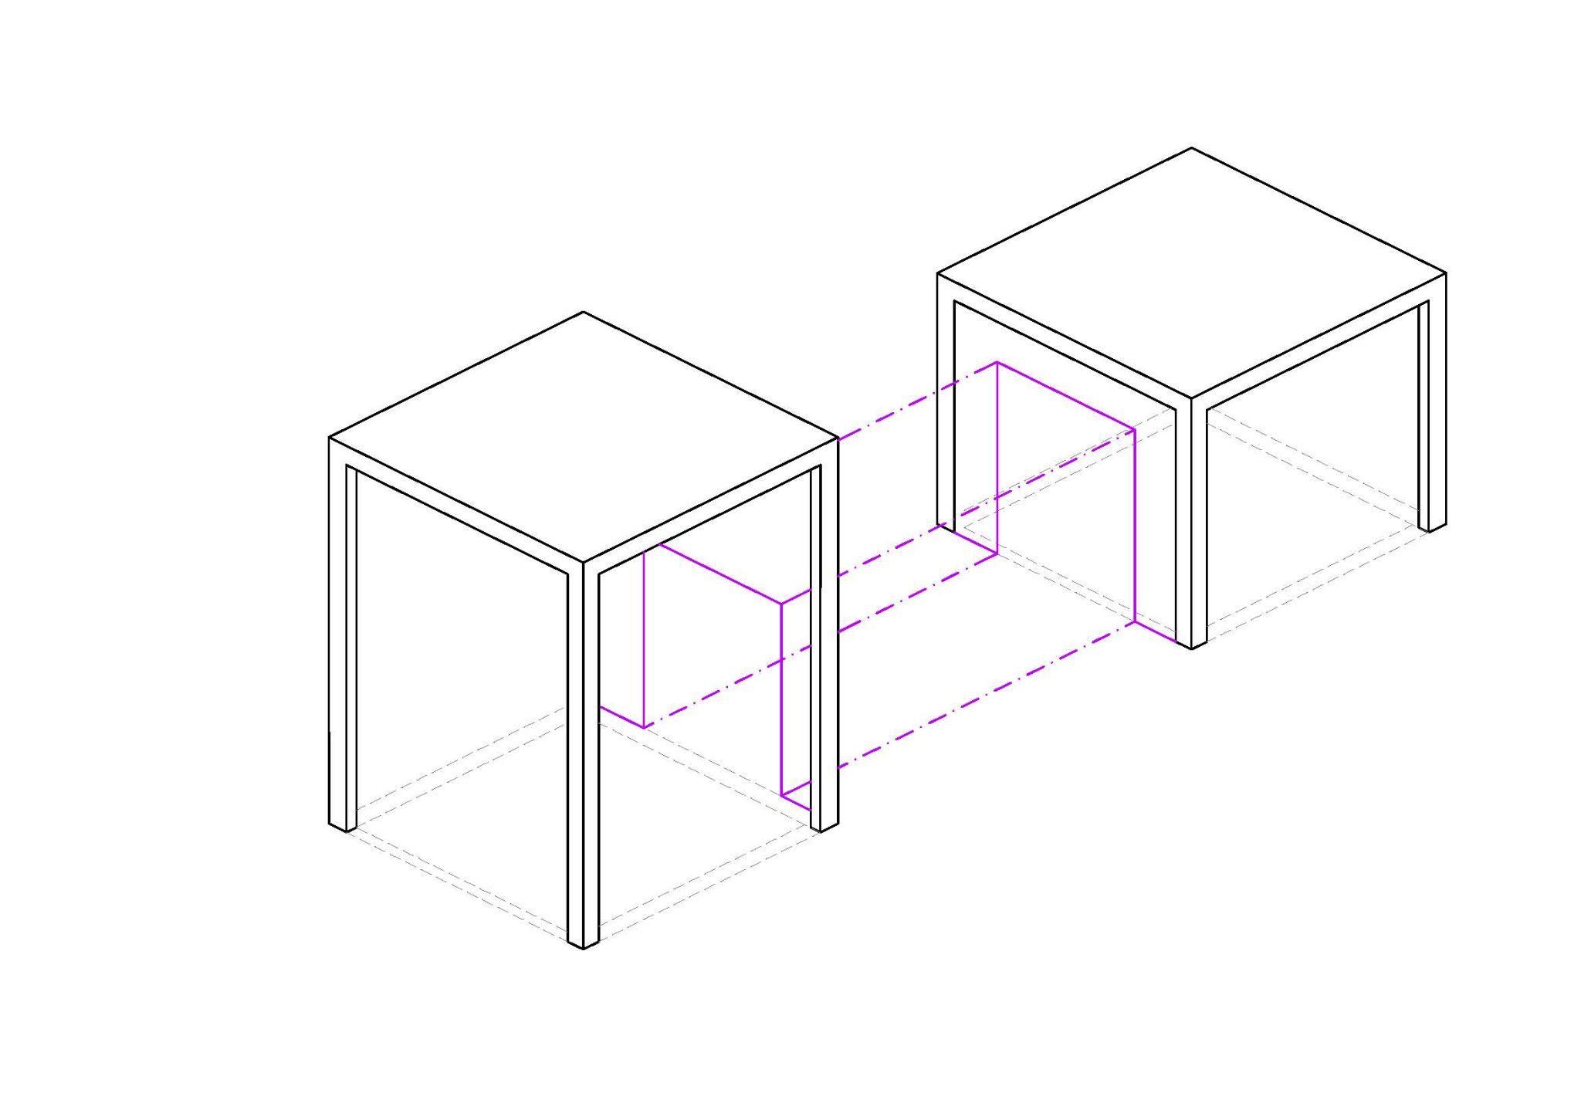
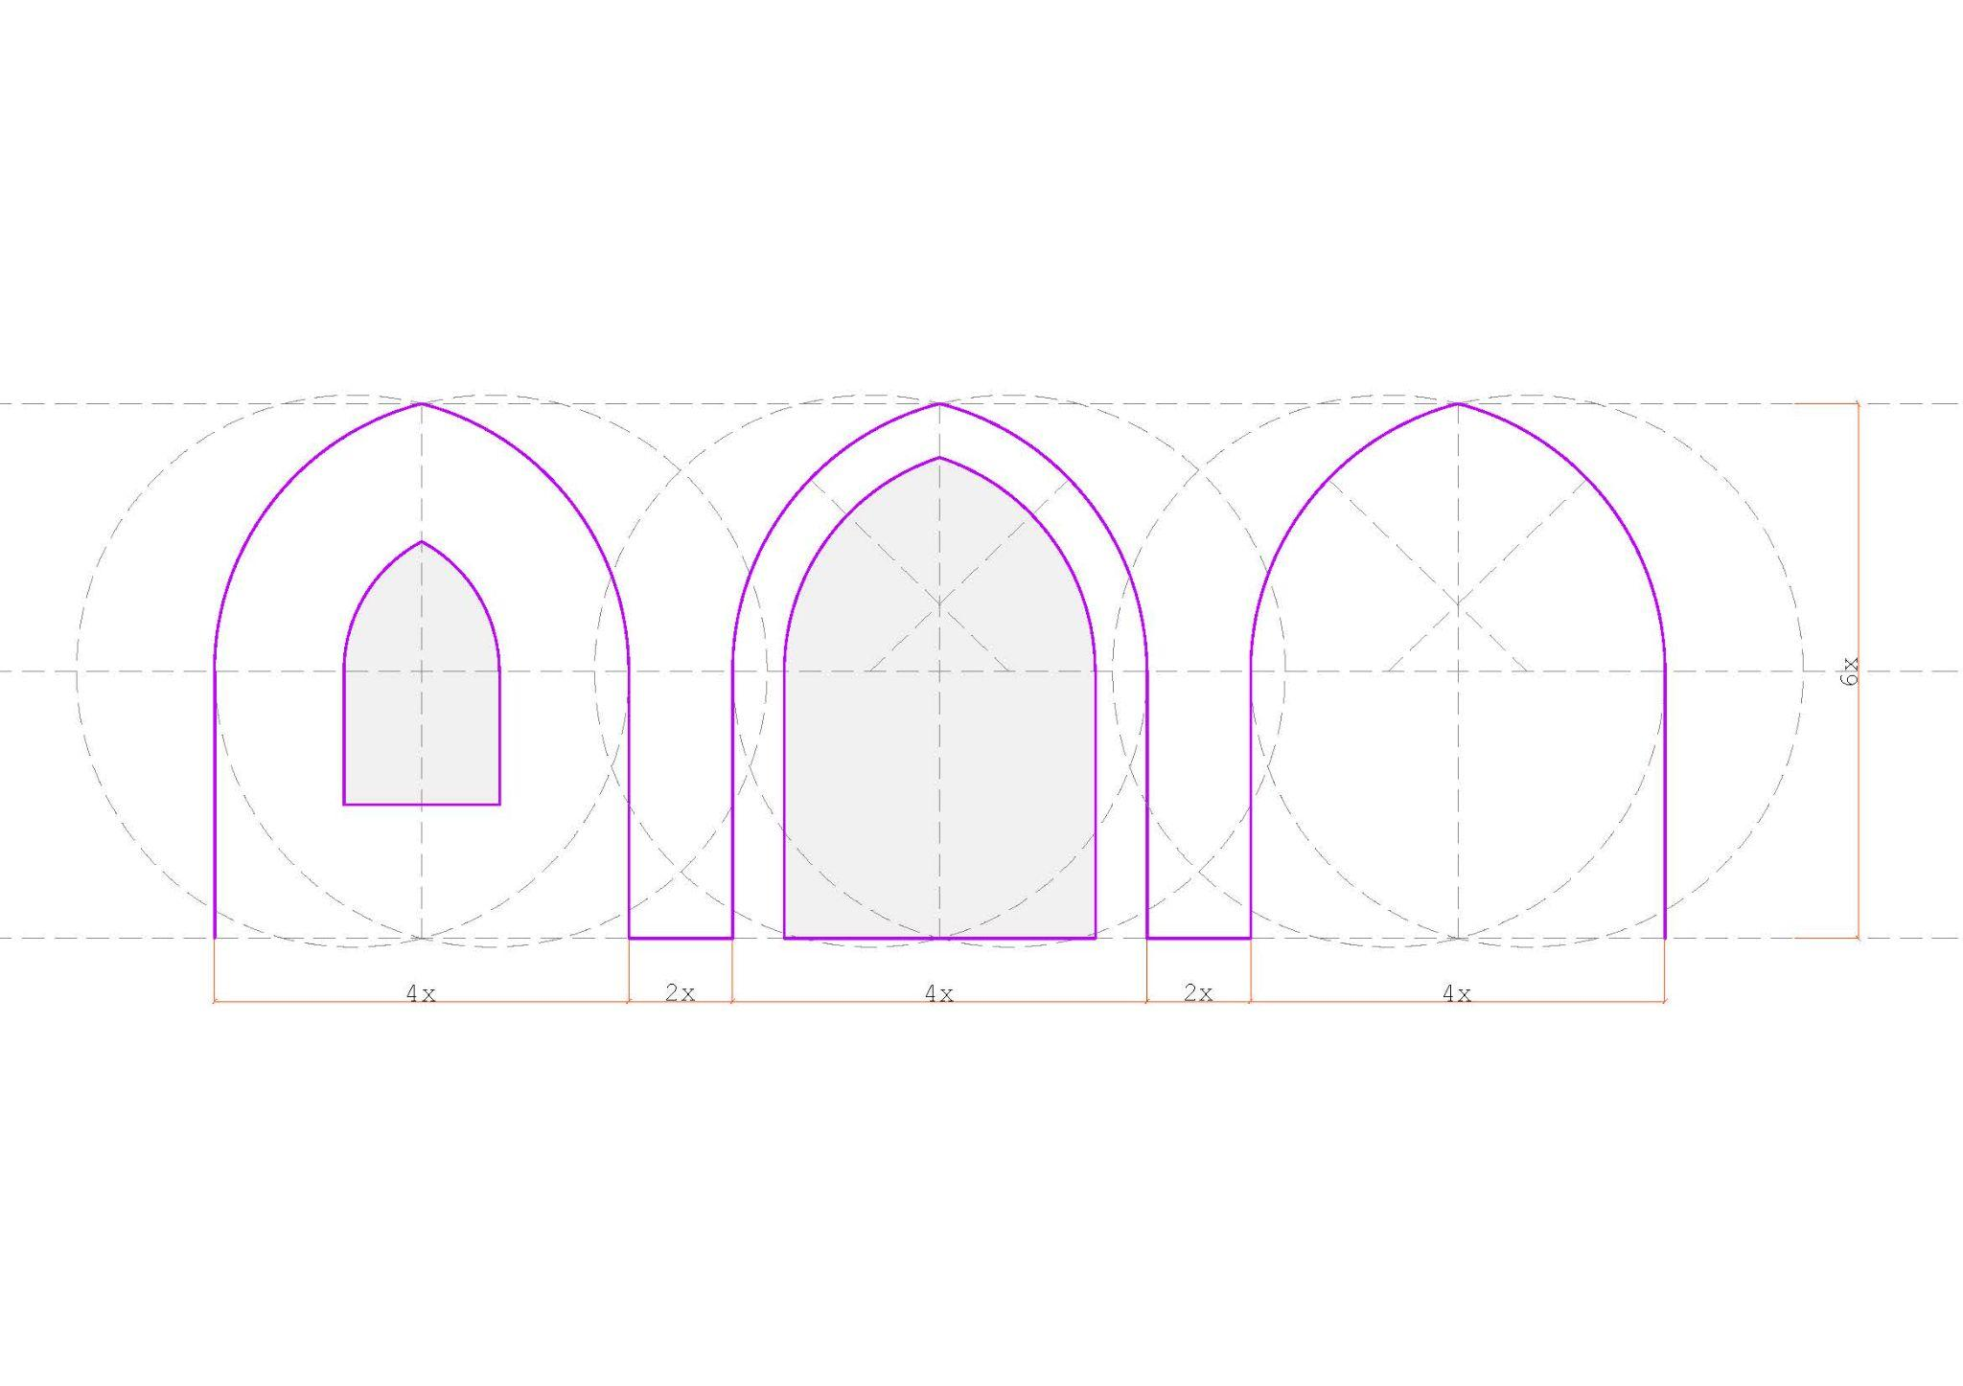
Simplification
Shaping
Align the opening sizes within the walls of different units
Proportions behind setting up the opening

Slide 29
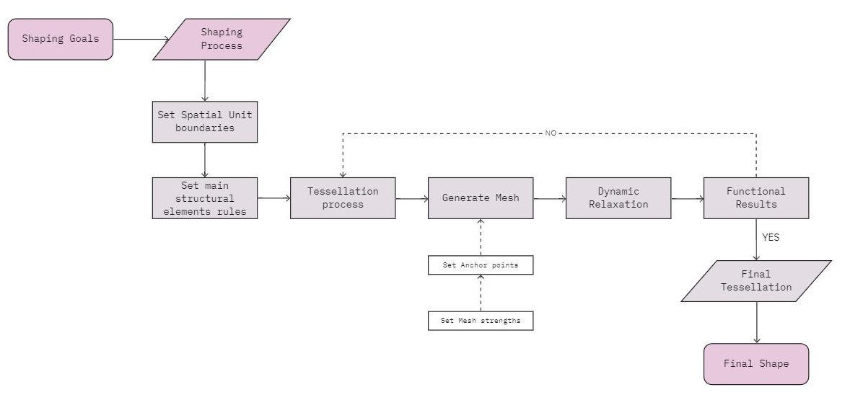
Tessellations Workflow
Shaping

Slide 30
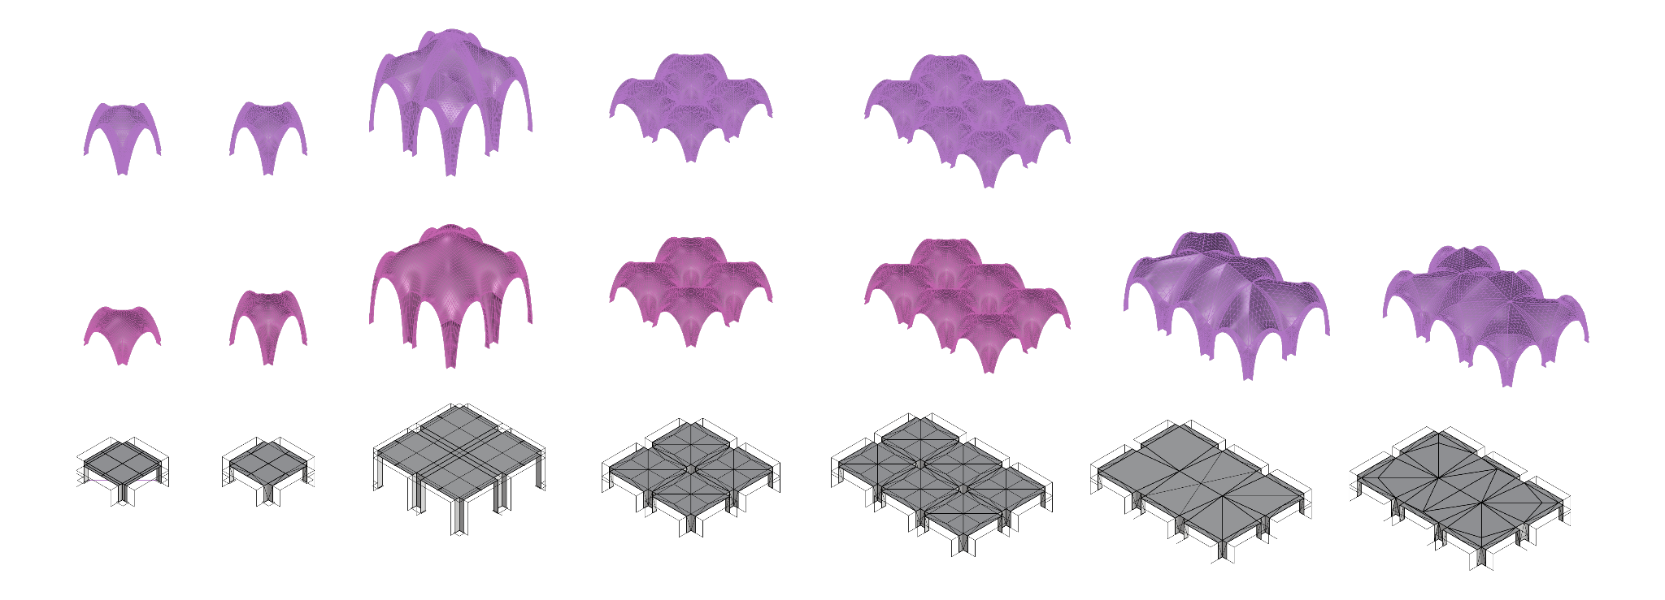
Tessellations- Initial Explorations
Shaping
1x1 Spatial Unit
2x2 Spatial Unit
3x2 Spatial Unit

Slide 31
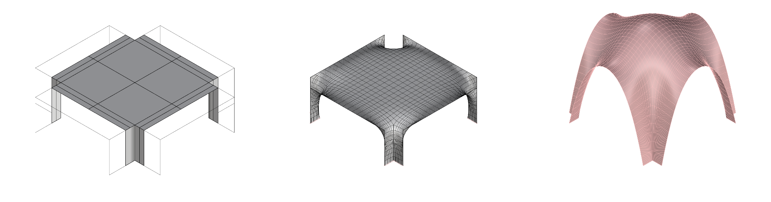
Chosen Tessellation- 1x1 Spatial Unit
Shaping
Main Tessellation
Quad Sub-division
Constant level - 3
Dynamically Relaxed Mesh
Length factor - 0.5
Strength - 5
Vertex load - 0.05

Slide 32
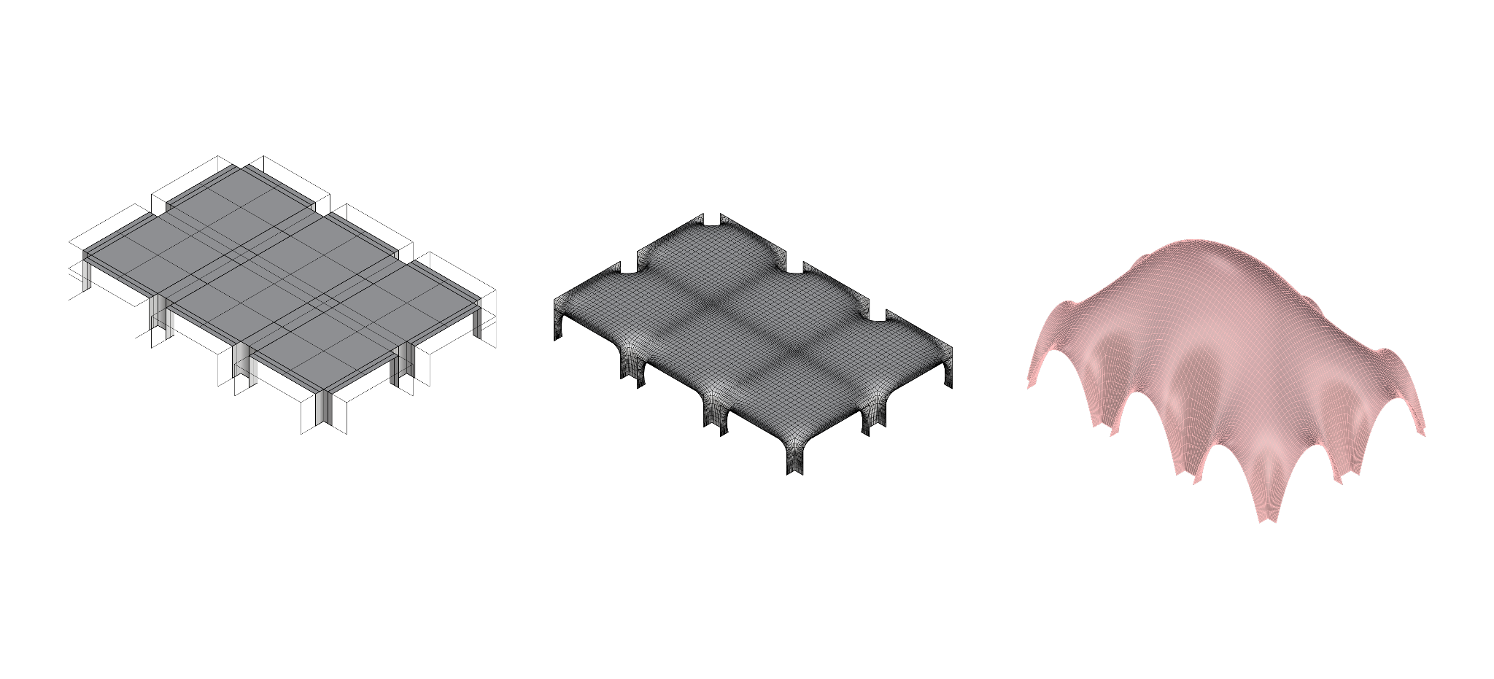
Chosen Tessellations- 3x2 Spatial Unit
Shaping
Main Tessellation
Quad Sub-division
Constant level - 3
Dynamically Relaxed Mesh
Length factor - 0.5
Strength - 7.5
Vertex load - 0.05

Slide 33
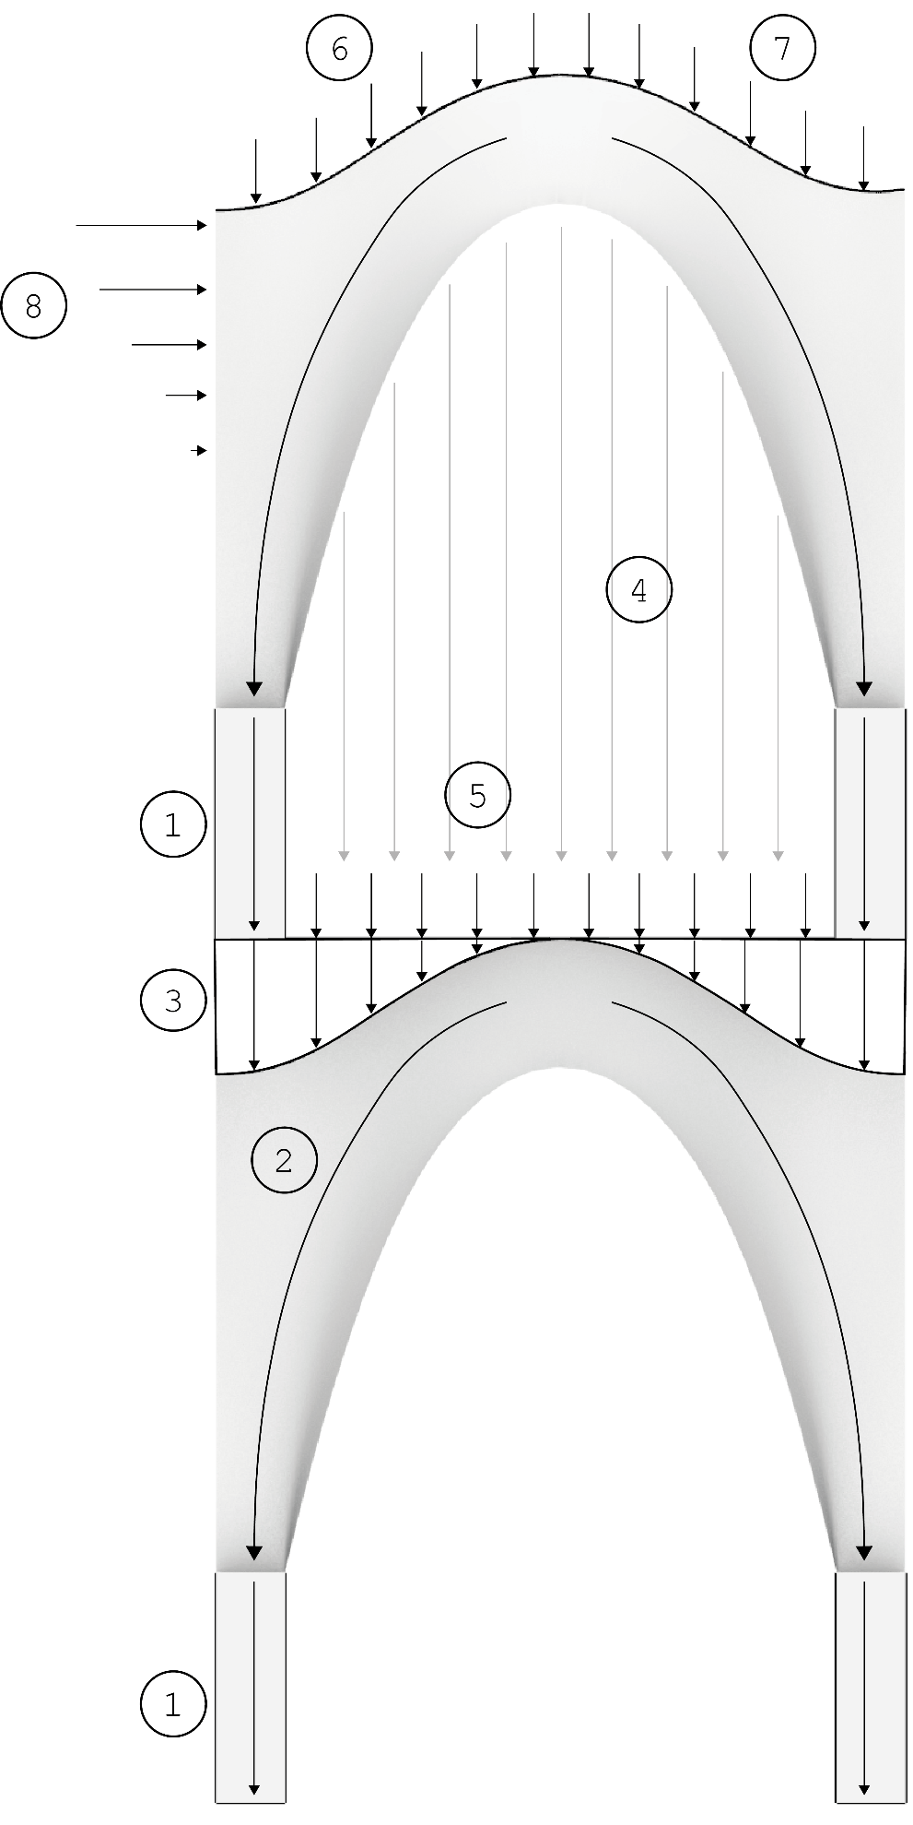
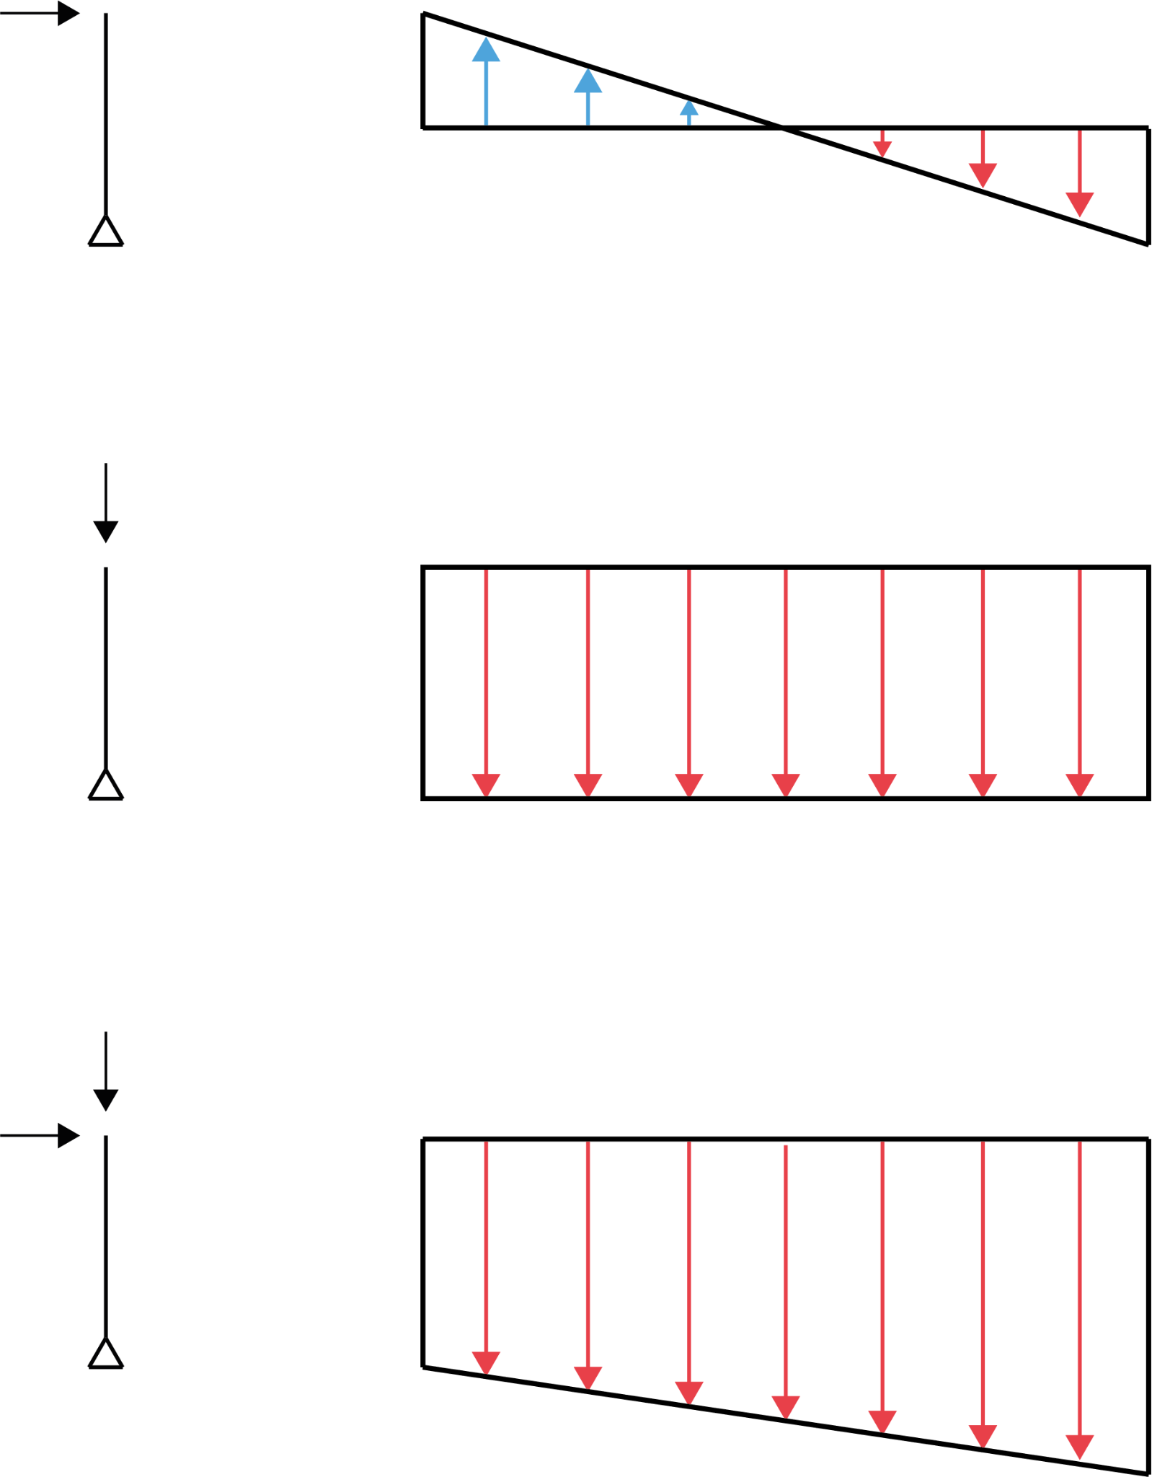
Load Considerations
0.3 kN
+0.06
0
0
-0.06
Vertical force on column
128 kN
0
0
-1.43
-1.43
Shaping
128 kN
0.3 kN
0
0
Dead load of columns
Dead load of shell
Dead load of sand infill
Dead load of walls
Live load on first floor
Live load on roof
Snow load
Wind load
-1.37
-1.49
Maximum compression: -1.50 N/mm²
Prefered tension: +0.00 N/mm²

Slide 34
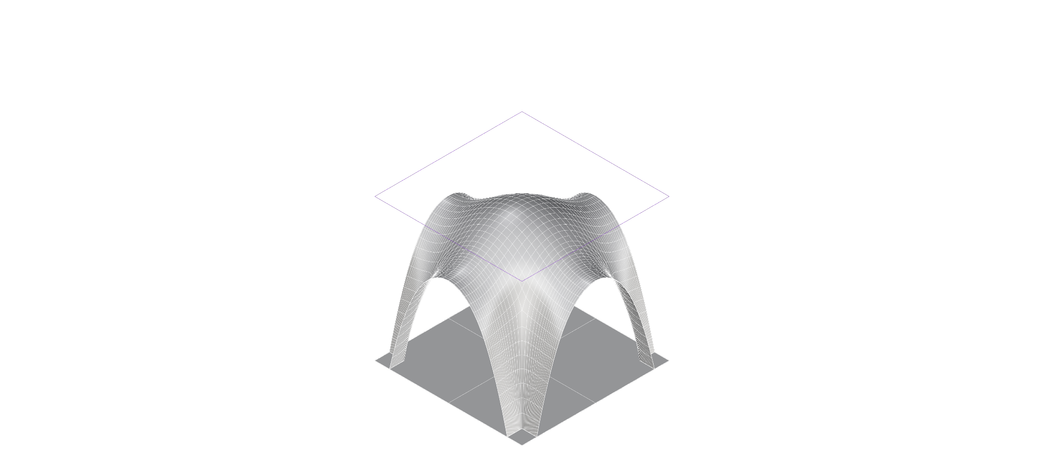
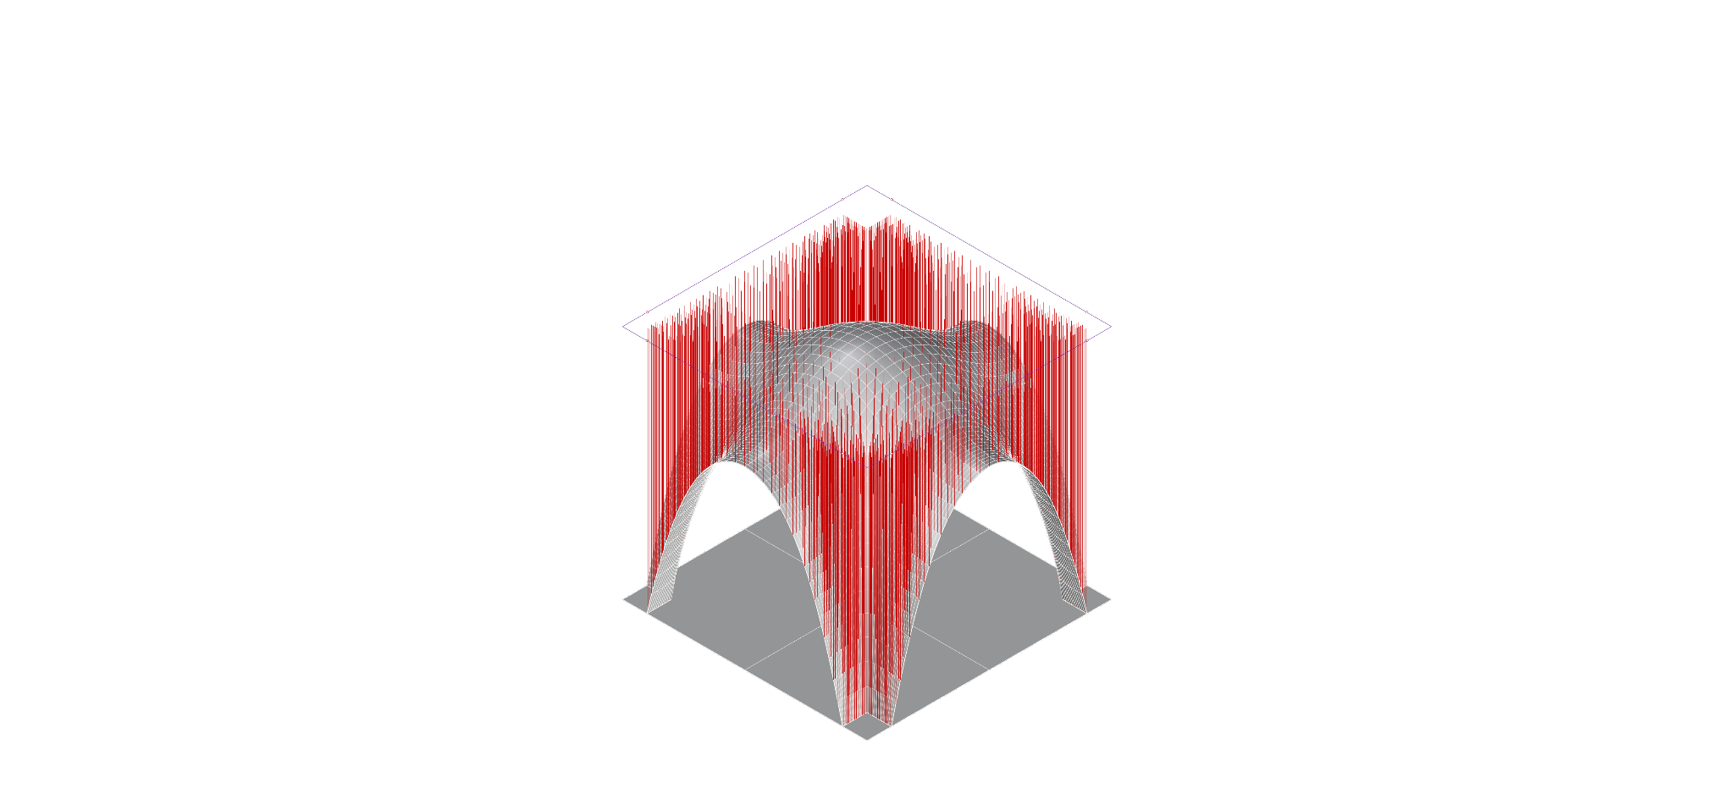
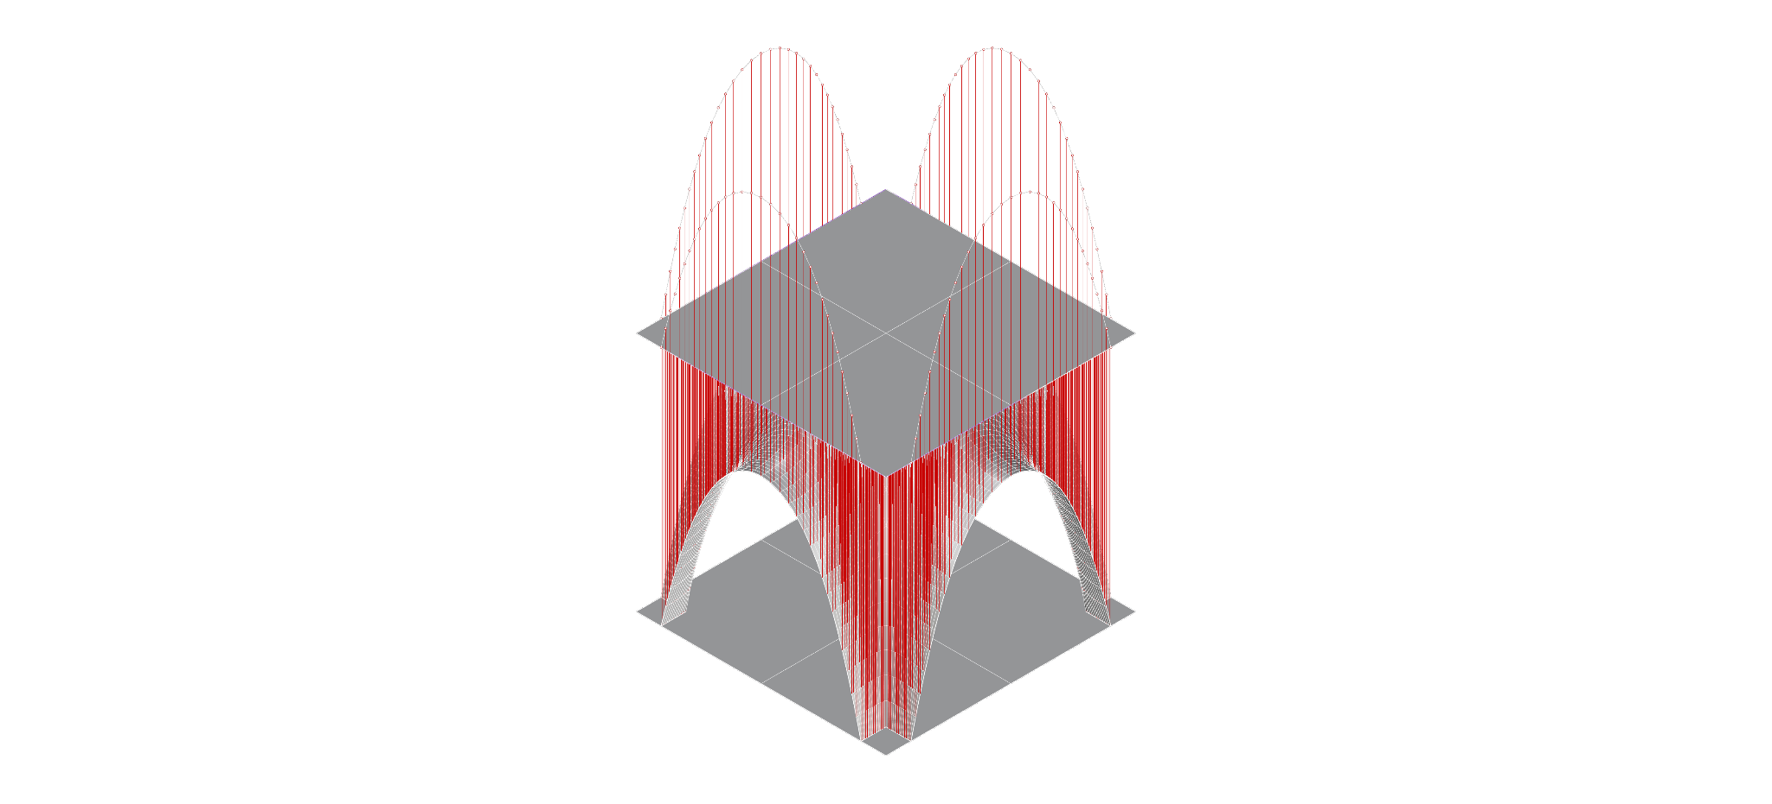
Material Properties & Load Cases
Material properties (table)
Karamba Analysis of Load cases
Family | Earth Blocks
Young’s Modulus (KN/cm²) | 11
Density (KN/m³) | 15
Shell thickness (m) | 0.3
Compressive Strength (kN/cm²) | -15.0e⁻²
Tensile Strength (kN/cm²) | +1.50e⁻²
Shaping
Material Properties_karamba
Case 1: Without first floor
Case 2: With first floor
Self Weight
Wind Load
Snow Load
Live Load (roof)
Wall Infill
Sand Infill
Self Weight
Wind Load
Snow Load Live Load (roof)
Live Load (first flr)

Slide 35
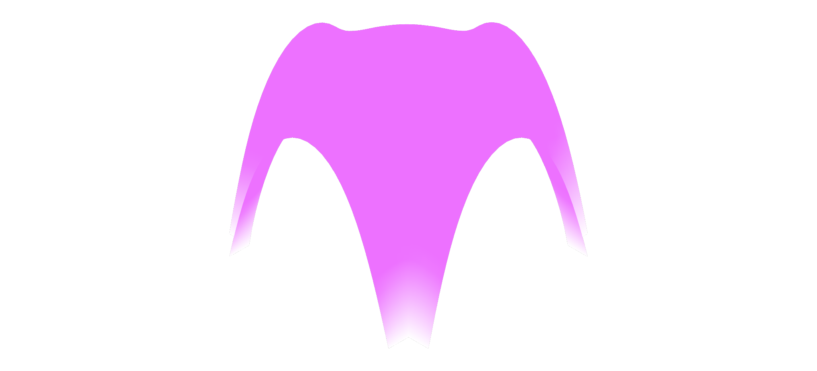
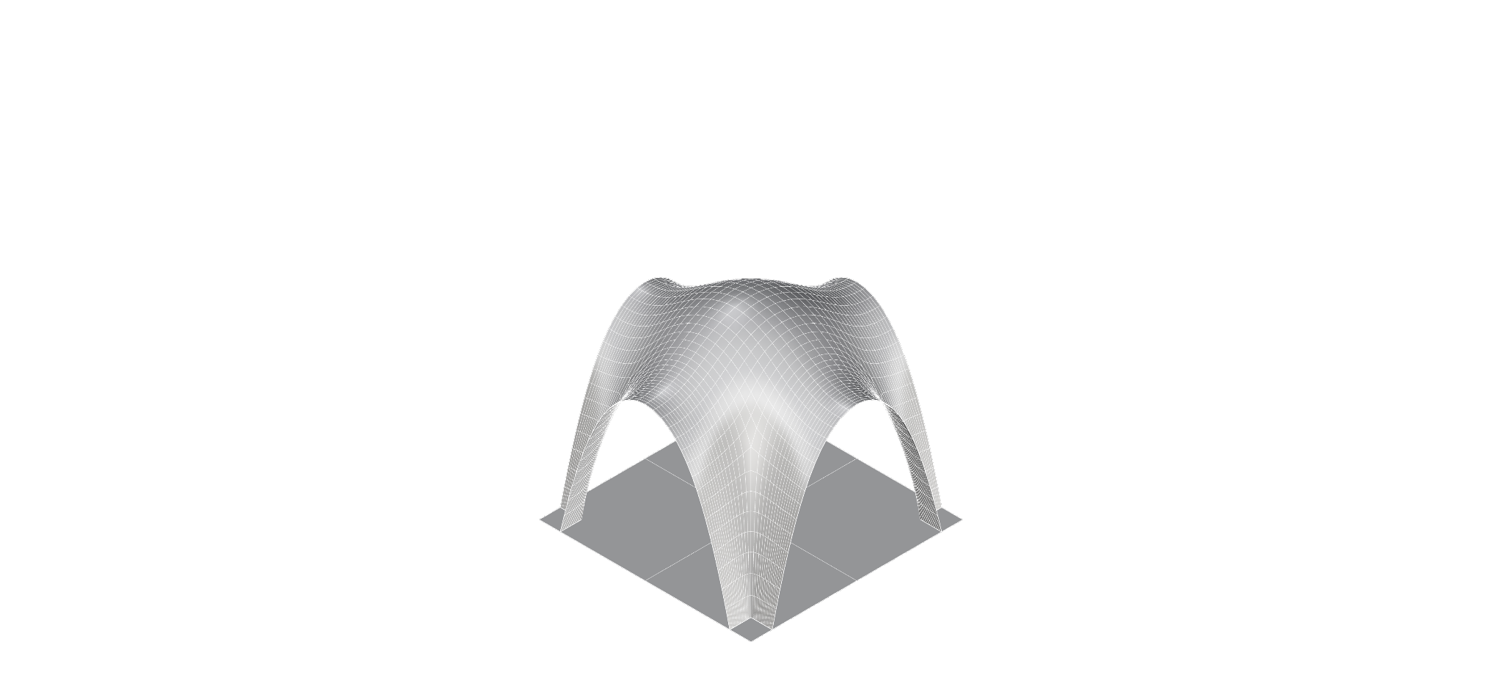
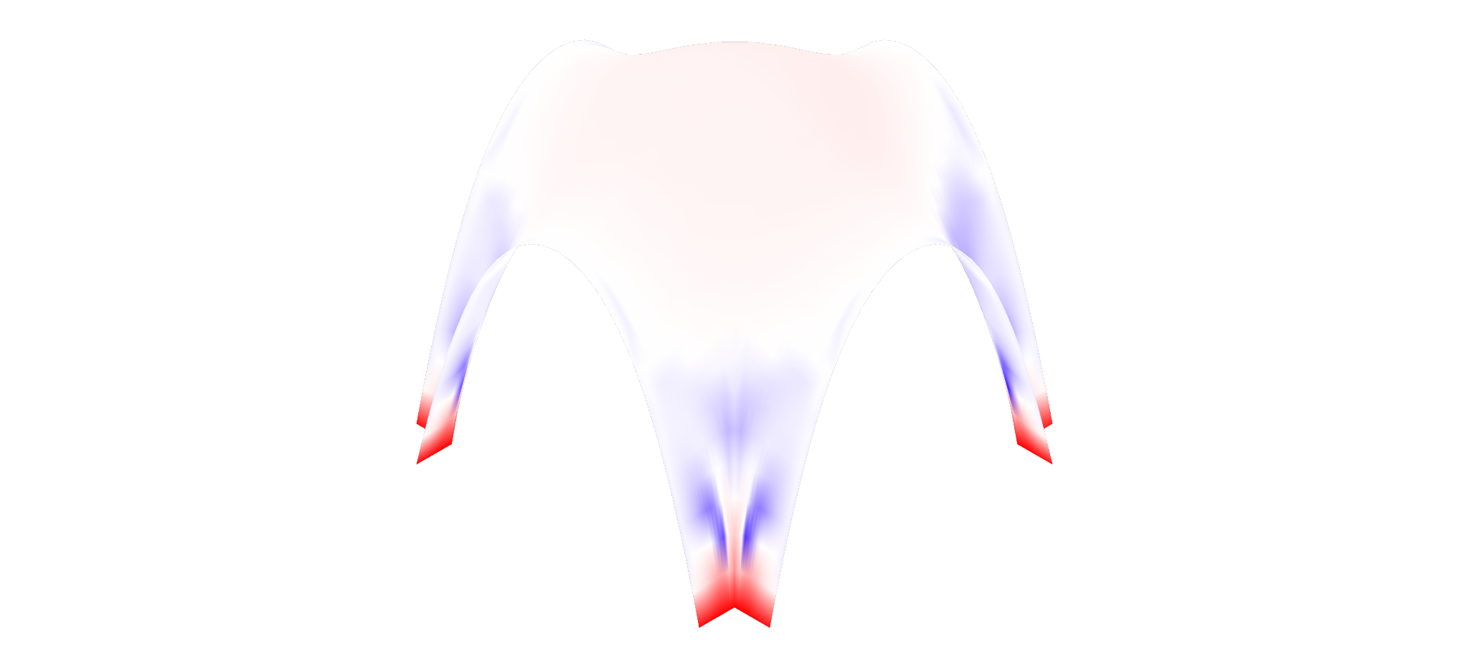
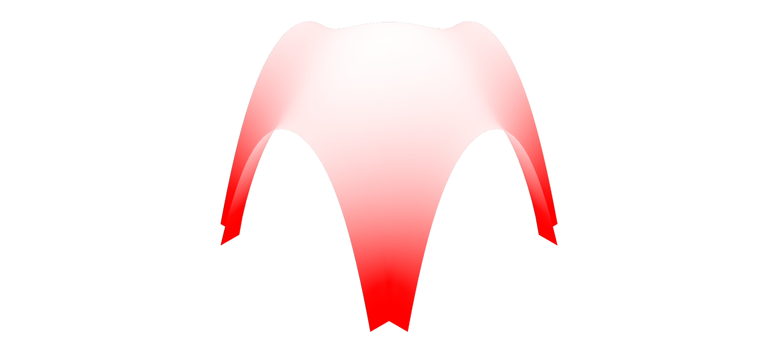
Structural Analysis_Shell
Shell analysis karamba
Unit Size: 3m x 3m
Number of Supports: 4
Column Size: 0.3m x 0.3m
Apex height: 3.9m
Max tensile: 1.5 kN/cm²
Max compression: 0.15 kN/cm²
Max displacement: 1.50cm
25% deformation
1.31e⁻¹ cm
Shaping
FEM Analysis_Displacement
-5.18e⁻² kN/cm2
-1.03e⁻¹ kN/cm²
+3.30e⁻³ kN/cm2
No Tension
Load Case 1: Without first floor
FEM Analysis_Tension
FEM Analysis_Compression

Slide 36
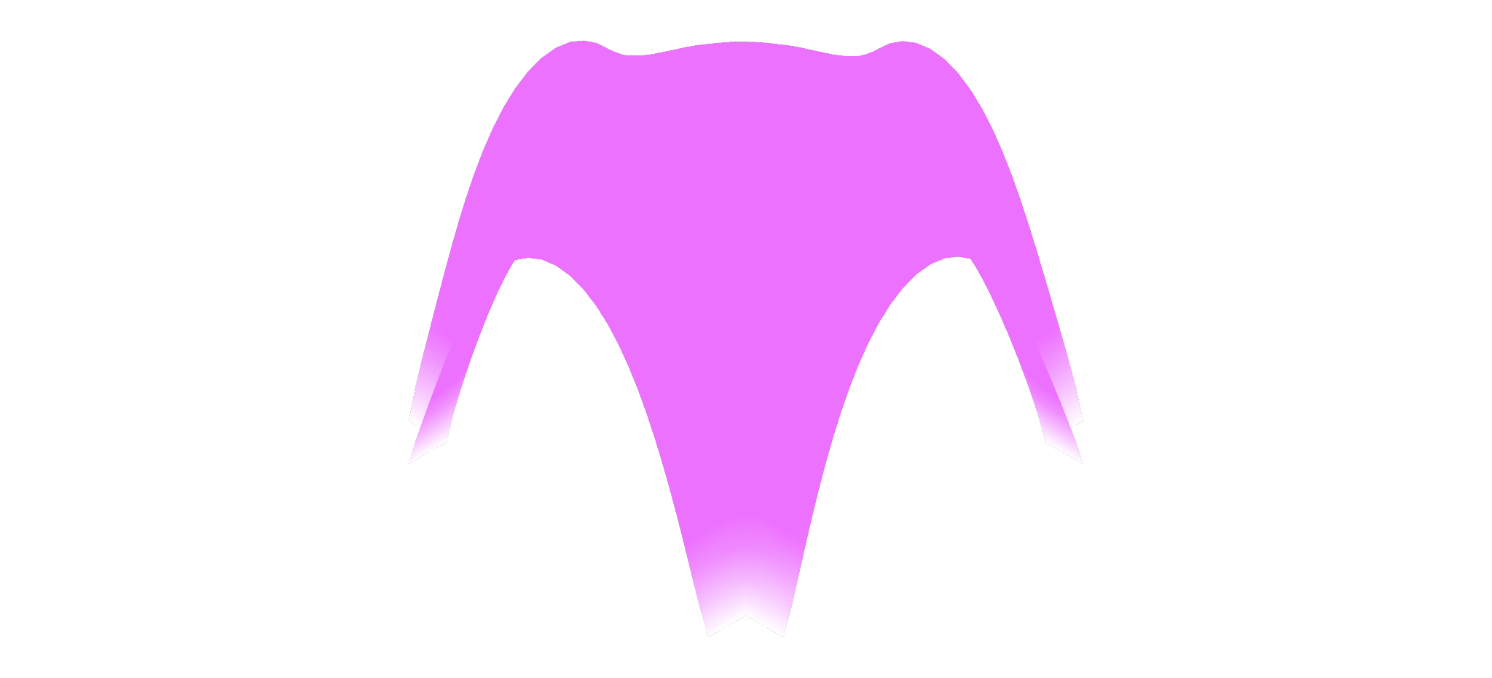


Structural Analysis_Shell
Shell analysis karamba
Unit Size: 3m x 3m
Number of Supports: 4
Column Size: 0.3m x 0.3m
Apex height: 3.9m
Max tensile: 1.5 kN/cm²
Max compression: 0.15 kN/cm²
Max displacement: 1.50cm
25% deformation
1.09e⁻¹ cm
Shaping
FEM Analysis_Displacement
-9.55e⁻³ kN/cm²
-2.53e⁻² kN/cm²
+2.68e⁻³ kN/cm²
+3.72e⁻⁴ kN/cm²
Load Case 2: With First floor
FEM Analysis_Tension
FEM Analysis_Compression

Slide 37




Structural Analysis_Shell
Shell analysis karamba
Unit Size: 9m x 6m
Number of Supports: 16
Column Size: 0.3m x 0.3m
Apex height: 6.5m
Max tensile: 1.5 kN/cm²
Max compression: 0.15 kN/cm²
Max displacement: 3.0cm
25% deformation
2.10e⁻¹ cm
Shaping
FEM Analysis_Displacement
-1.84e⁻² kN/cm²
-5.35e⁻² kN/cm²
+1.45e⁻² kN/cm²
+3.96e⁻⁵ kN/cm²
Load Case 1: Without First floor
FEM Analysis_Tension
FEM Analysis_Compression

Slide 38



Staircase Principle
Shaping

Slide 39


Staircase Principle
Shaping
Staircase Shell

Slide 40


Wall Infills
Shaping
Shells 3x2 and 1x1
W-01
W-02
W-03
W-04

Slide 41




Mesh to Blocks for Spatial Unit 1x1
Shell
Construction
Block Cluster
Final Unit
Stacked Blocks

Slide 42

Mesh to Blocks for Spatial Unit 1x1
Clay/silt 30%
Fine sand 30%
Coarse 40%
--------------
Dry materials 100%
Added water 110%
Construction
500
300
200
150
100
300
300
300
300
300
300
300
300
300
300
Stacked Blocks

Slide 43

Spatial Unit 3x2
Construction

Slide 44

Staircase
Construction

Slide 45


Truss Method
Construction

Slide 46

Truss Method
Maximum compressive stress: -0.22 kN/cm²
Maximum allowable compressive stress: -0.15 kN/cm²
Maximum tensile stress: +0.14 kN/cm²
Maximum allowable tensile stress: +0.015 kN/cm²
Construction

Slide 47

Wall Connection
Construction

Slide 48


Construction Sequence for a Room
Construction

Slide 49

Process Overview

Slide 50

Building Overview
Construction
3x2
1x1
1x1
2x2
5.4m
2.4m
2.4m
5.4m
Notes:
What have we achieved - 2 floors, etc etc

Slide 51

Rainwater pipelines
Construction

Slide 52


Slide 53


Slide 54

Final Plan (voxel)

Slide 55

Front Elevation
Construction
Womens & Children HU
PHU
Education Hall
Pharmacy
Lobby
Kitchen
Wards

Slide 56




The Game
3. Properties of Spatial Unit
1. About the Zone
2. Current Spatial Unit
Conclusion
Notes:
We configured a game which can be played manually and digitally

Slide 57
The Urban Plan
Conclusion

Slide 58






Reflection and Further Developments
Better Integration of First Floor It was not a priority to provide an access through a ramp, and hence it is only possible to place administrative functions above.
More Evaluation Criteria Currently in the configuration, we only include ‘least possible circulation tiles’.
Game Control The user is given high control to place the functions, which might not result in the best design (ventilation, daylight)
Gamifying the whole process Walls are now only placed manually. Staircase is configured manually.
Spatial Variation We wanted to have a columnless 2x2 module, but they were not possible with a first floor.
Material Optimization The materials need to be reduced by scooping out extra earth from the blocks.
Conclusion

Slide 59

Questions?
Take CARE(THY)
Anurag
Diederik
Karin
Pragya

